Slide 1


Slide 2
Forum
CSE - 618
Group Members:
Moinuddin Kader, ID: 17701016
Naimur Rahman, ID: 17701045

Slide 3
Content
Problem Statement
Problem Solution
What we already have implemented
Tools/ Technologies we have used
Activity Flow diagram
Use Case diagram
Class diagram
Sequence diagram
Some snapshots of the App
Future work
Questions

Slide 4
Problem Statement
No medium to discuss health issues
Can not ask anything through messages
Not able to connect similar patients individually
Can’t locate users in the vicinity
Real time Covid-19 data to aware users

Slide 5
Problem Solution
User
Patients
Doctors
Usage
Post about his/her health disorder
View posts of the others
Interact with that post creator via direct chatting or commenting.
Find out all of the users using our platform at a glance
Update donation info
Find out donators on map
See the update of covid-19

Slide 6
What has already been implemented
Community based, but not specialized on health related issues.
No forum offers blood donation through their app.
Make profits showing ads or promoting particular medical center

Slide 7
What we are planning to implement
We plan to implement a Forum Project that will be dedicated to
Health related issues
No ads
No distractive contents
Maximum user friendly project interface to gain the most users
Individual text exchange
Blood donation

Slide 8
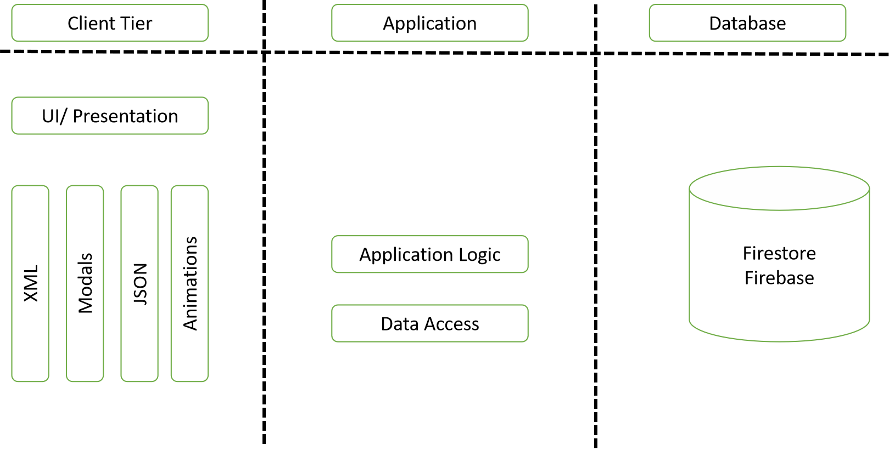
Tools/Tech we have used
3-tier Architecture
XML for UI and Java for logical coding
Firestore Realtime Database as backend

Slide 9
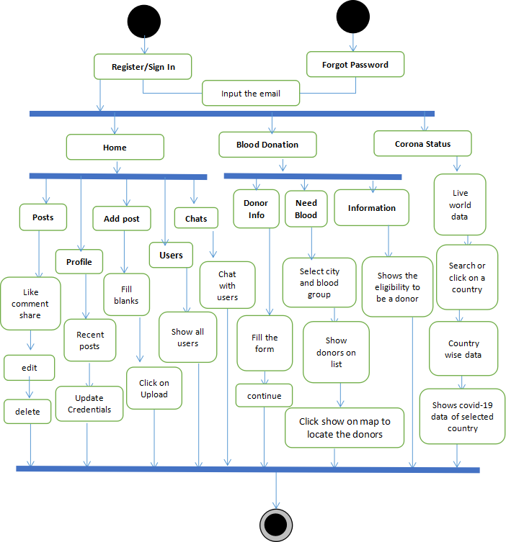
Activity Flow Diagram

Slide 10
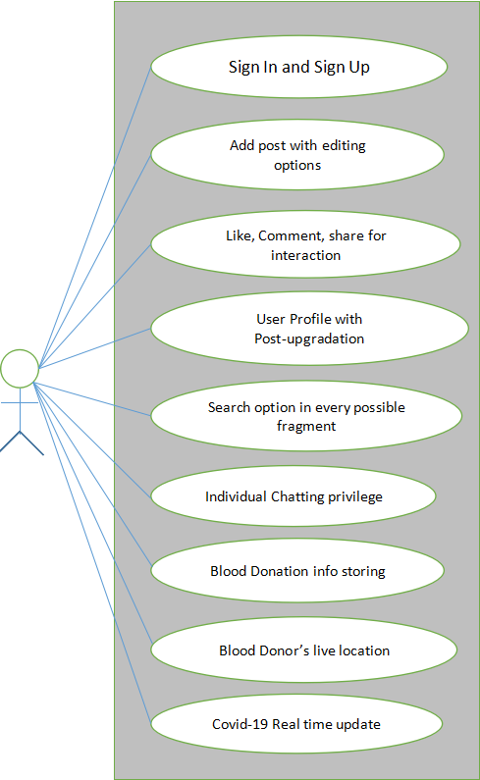
Use Case Diagram

Slide 11
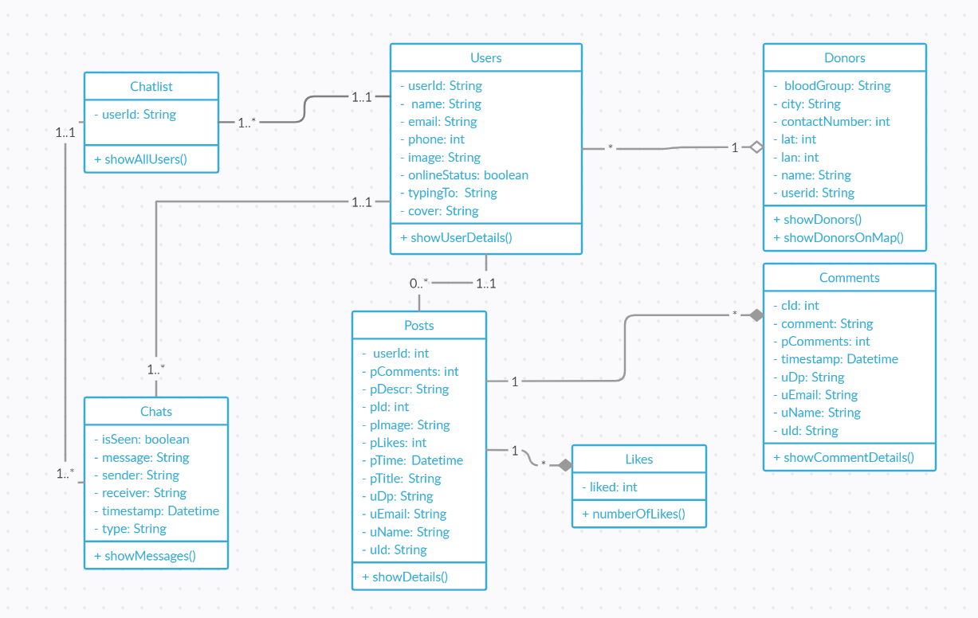
Class Diagram

Slide 12
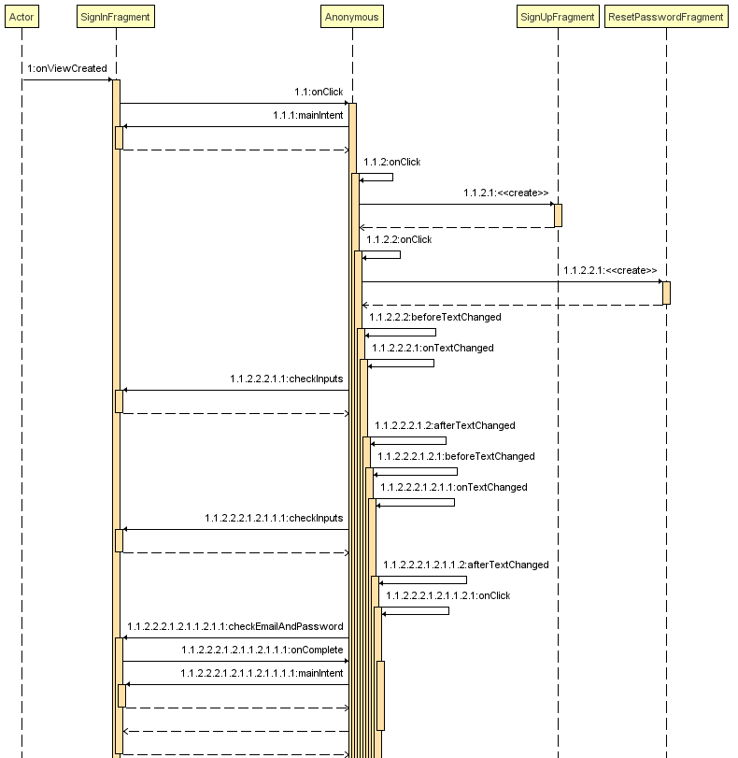
Sequence Diagram (Sign In)

Slide 13
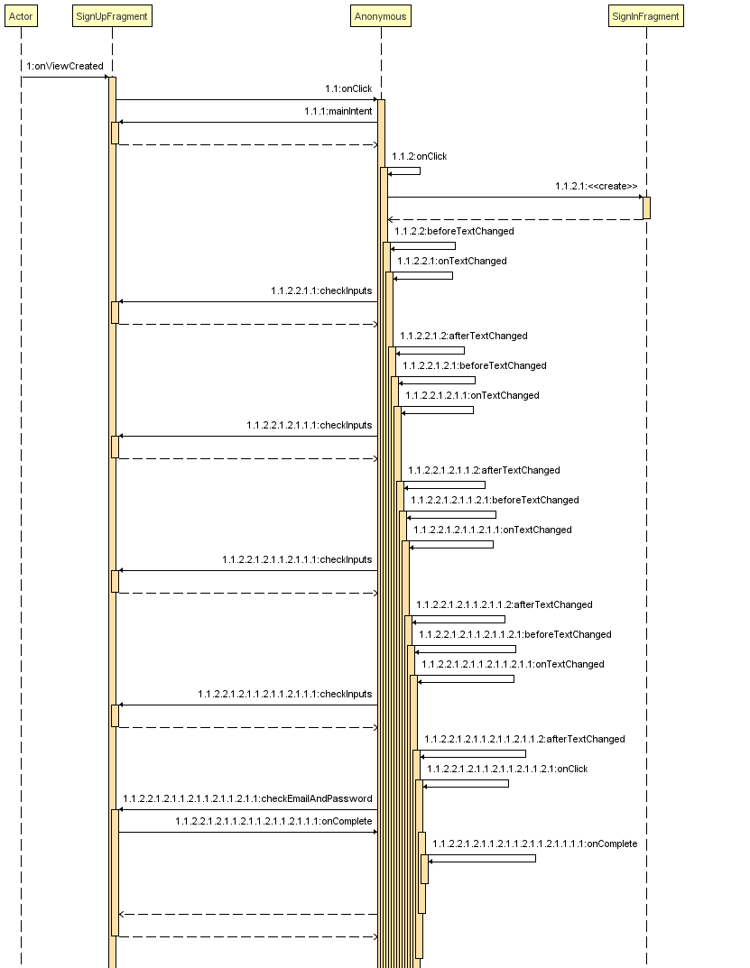
Sequence Diagram (Sign Up)

Slide 14
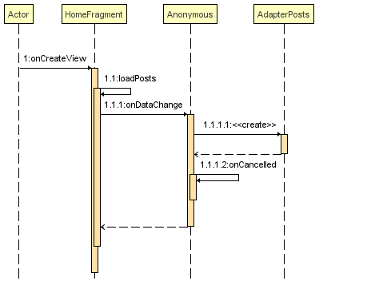
Sequence Diagram (Home)

Slide 15
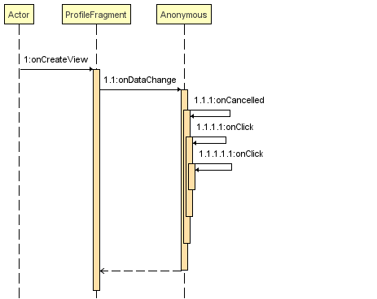
Sequence Diagram (Profile)

Slide 16
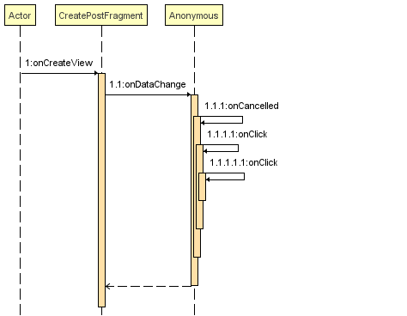
Sequence Diagram (Create Post)

Slide 17
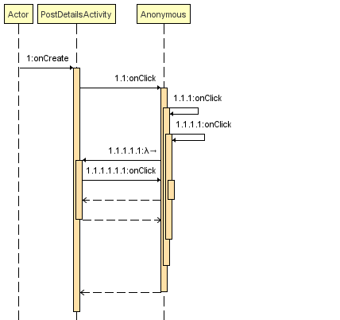
Sequence Diagram (Post Details)

Slide 18
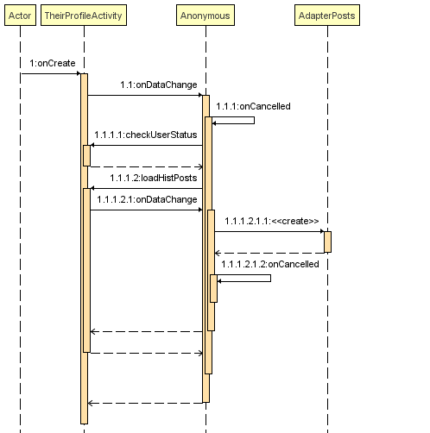
Sequence Diagram (Their Profile)

Slide 19
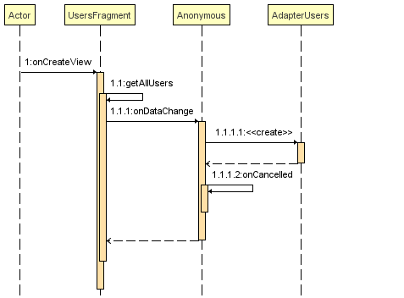
Sequence Diagram ( Users)

Slide 20
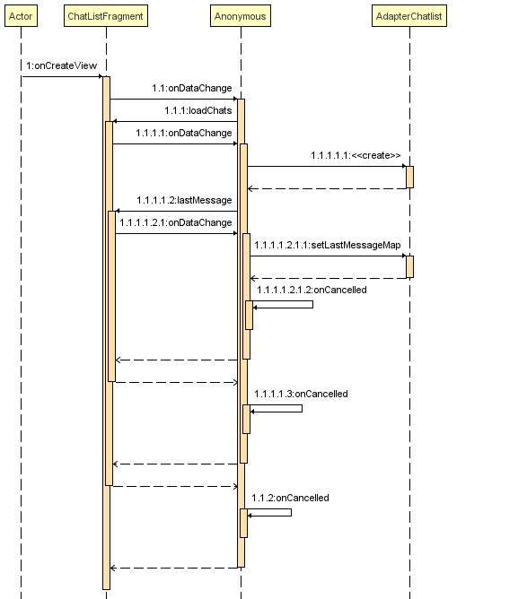
Sequence Diagram (Chats)

Slide 21
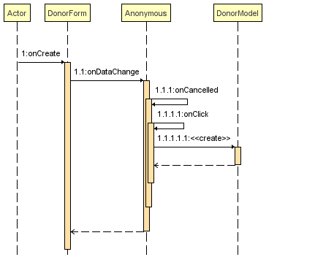
Sequence Diagram (Donors)

Slide 22
Some Snapshots of the App

Slide 23
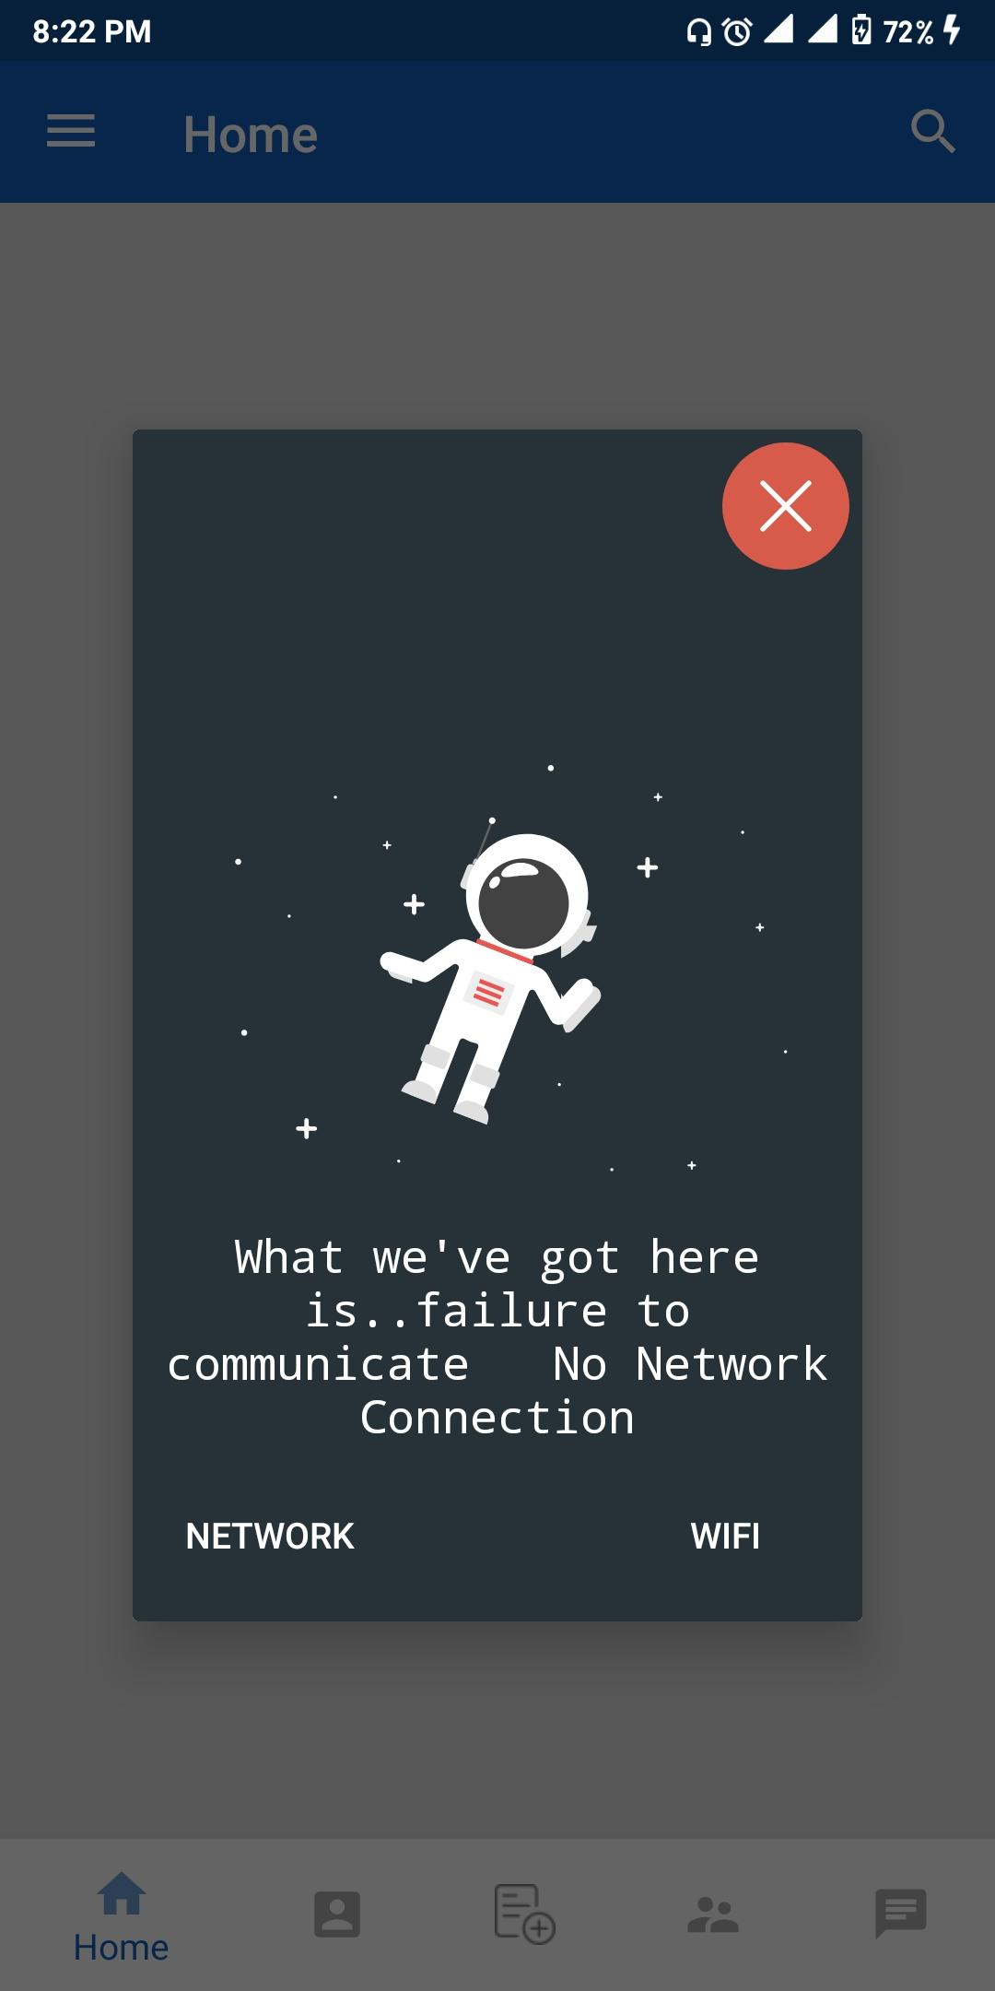
Internet Connection Failure Popup

Slide 24
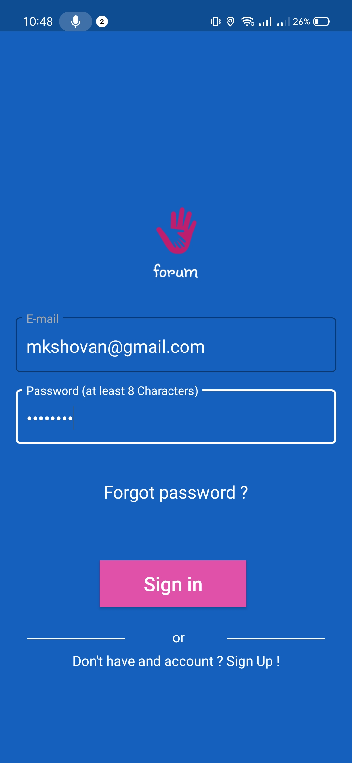
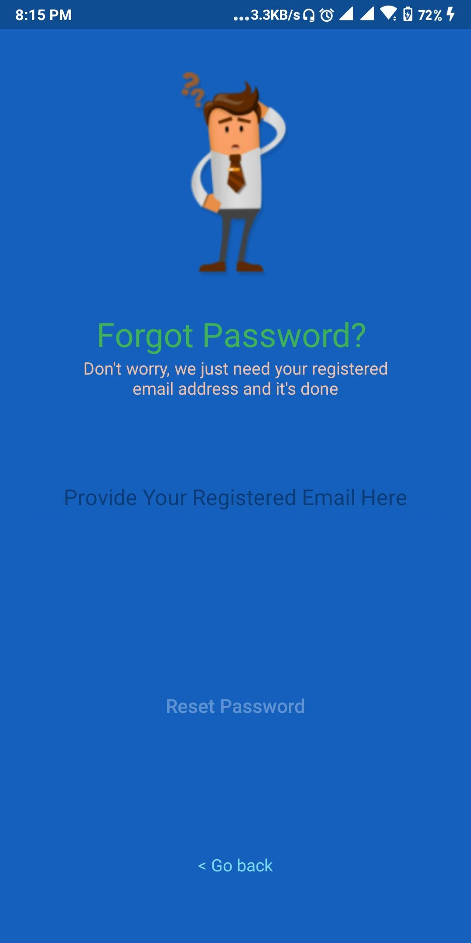
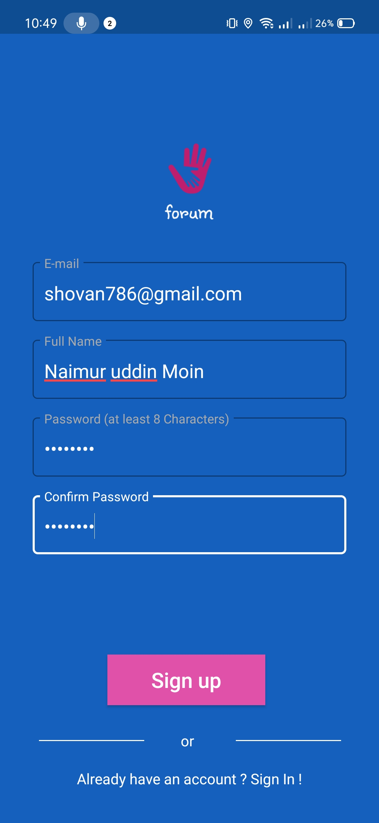
Sign In
Forgot Password
Sign Up

Slide 25
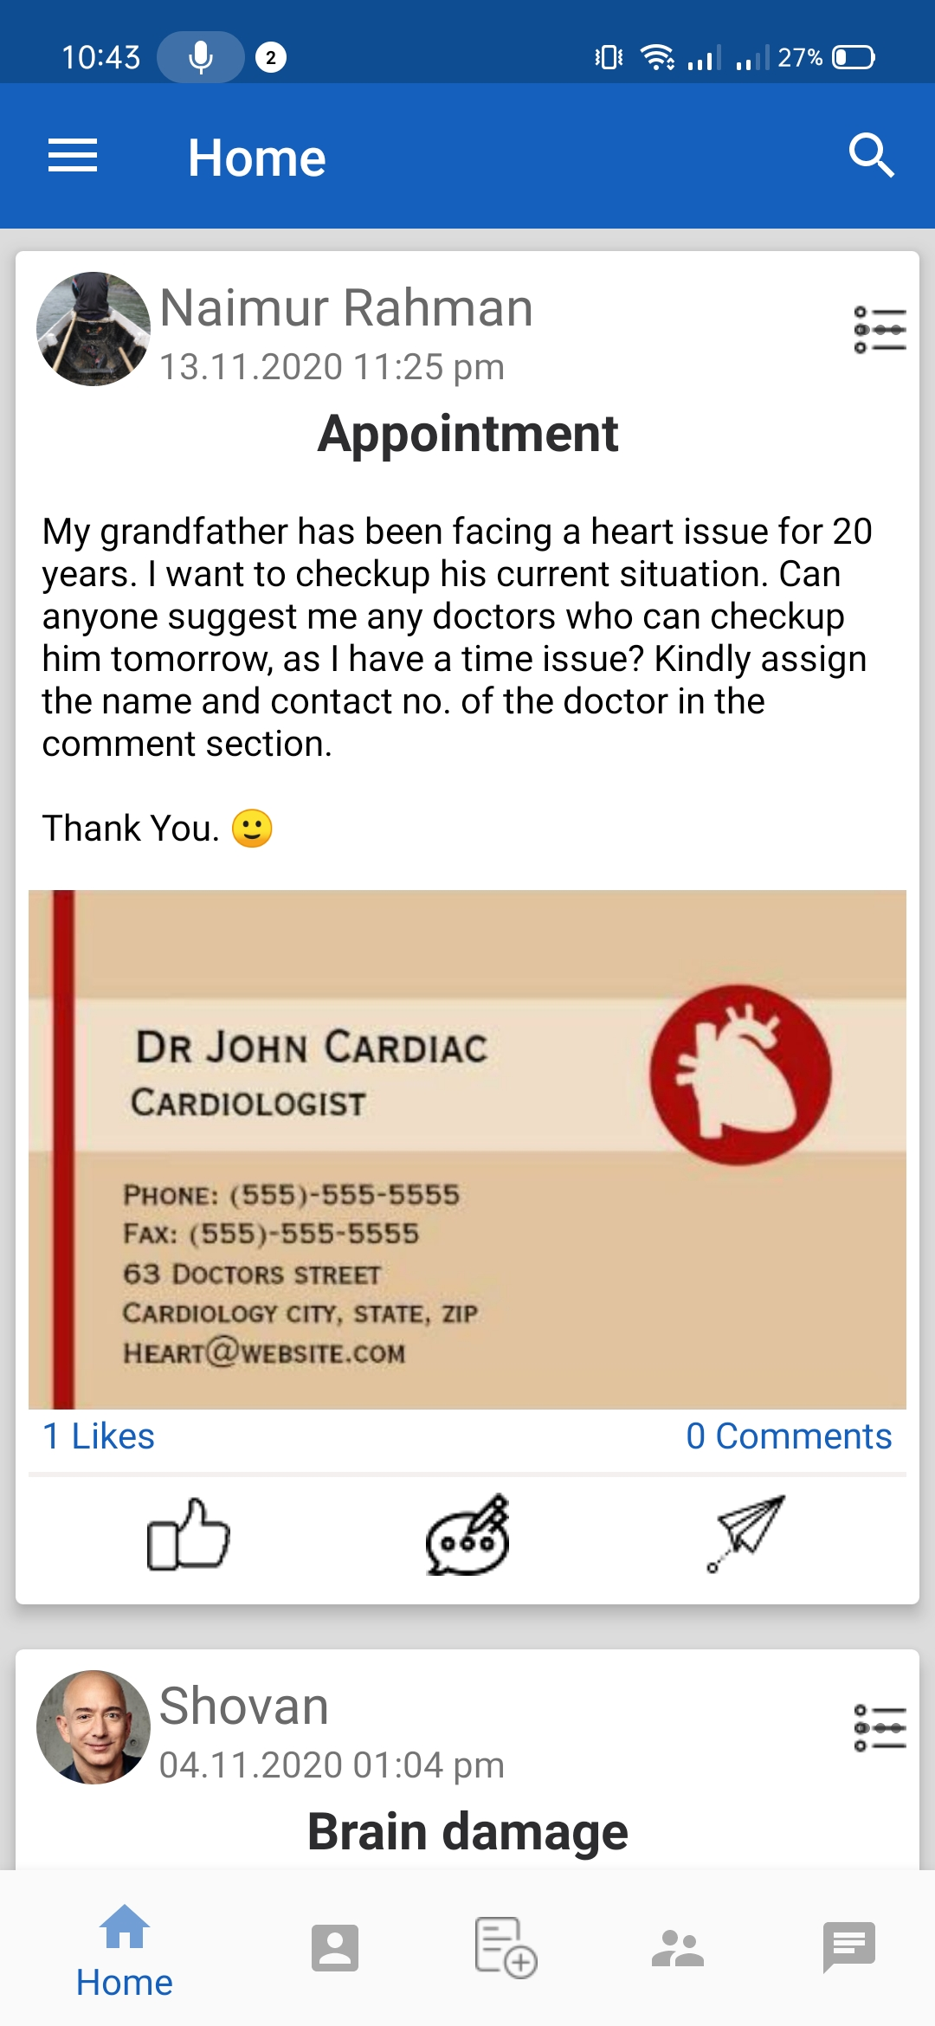
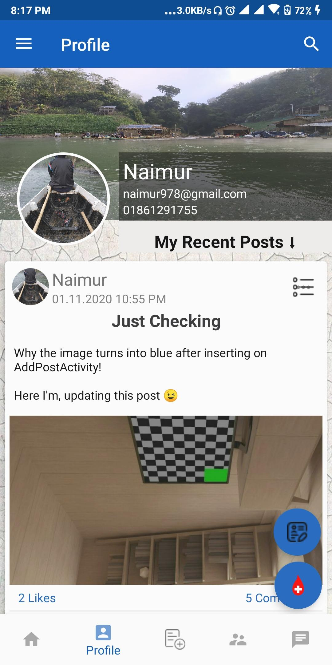
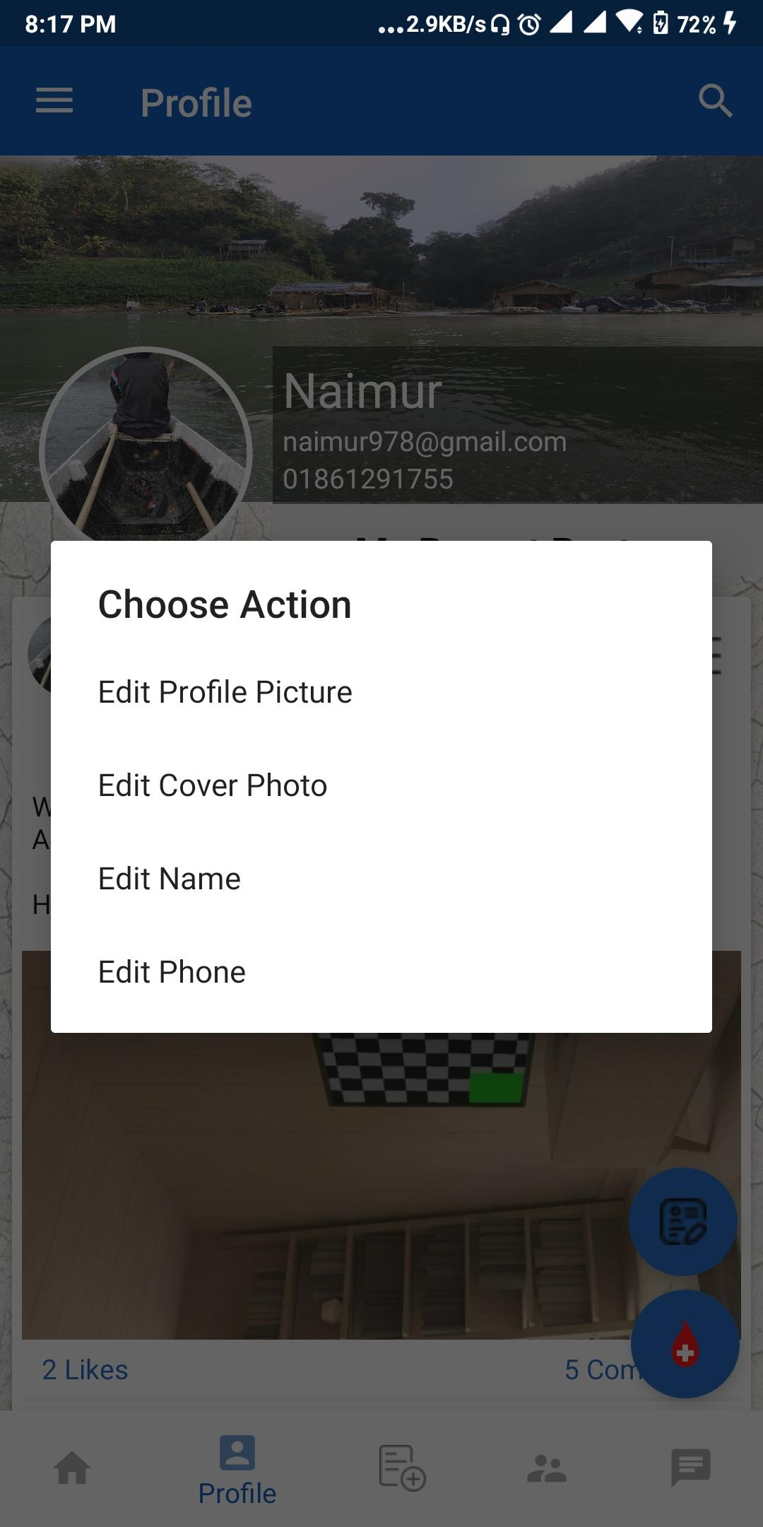
Home
Profile
Profile Action

Slide 26
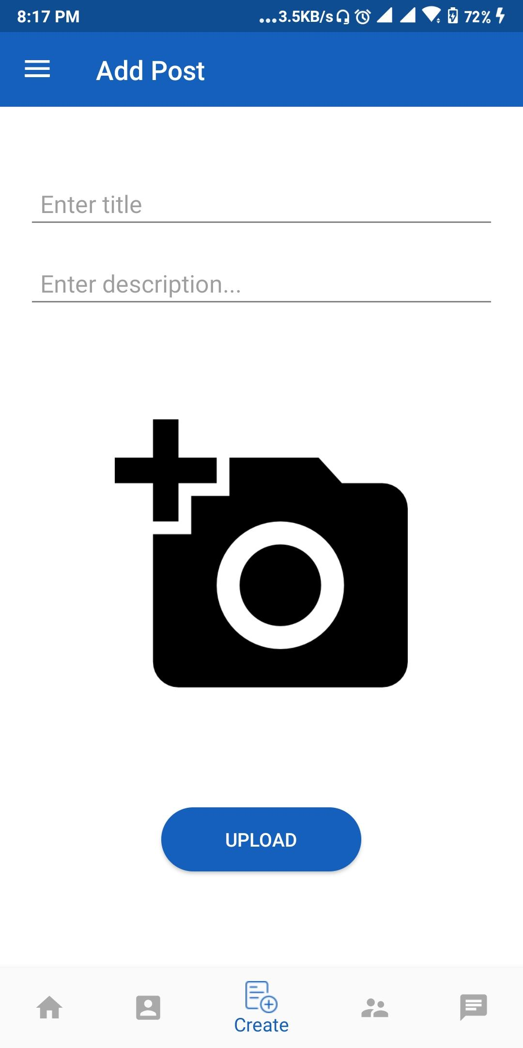
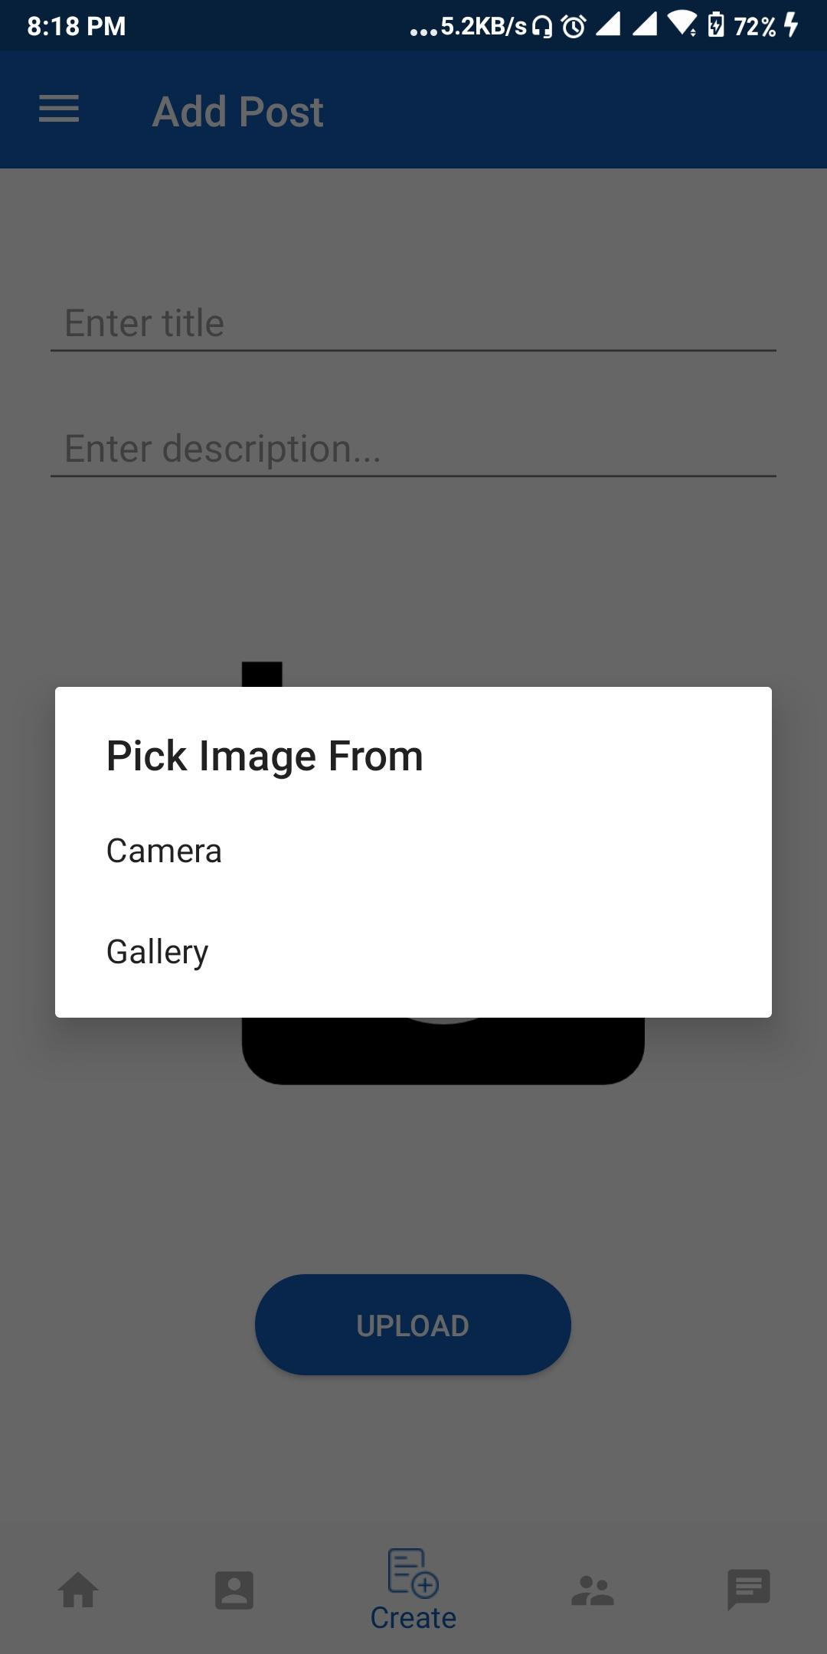
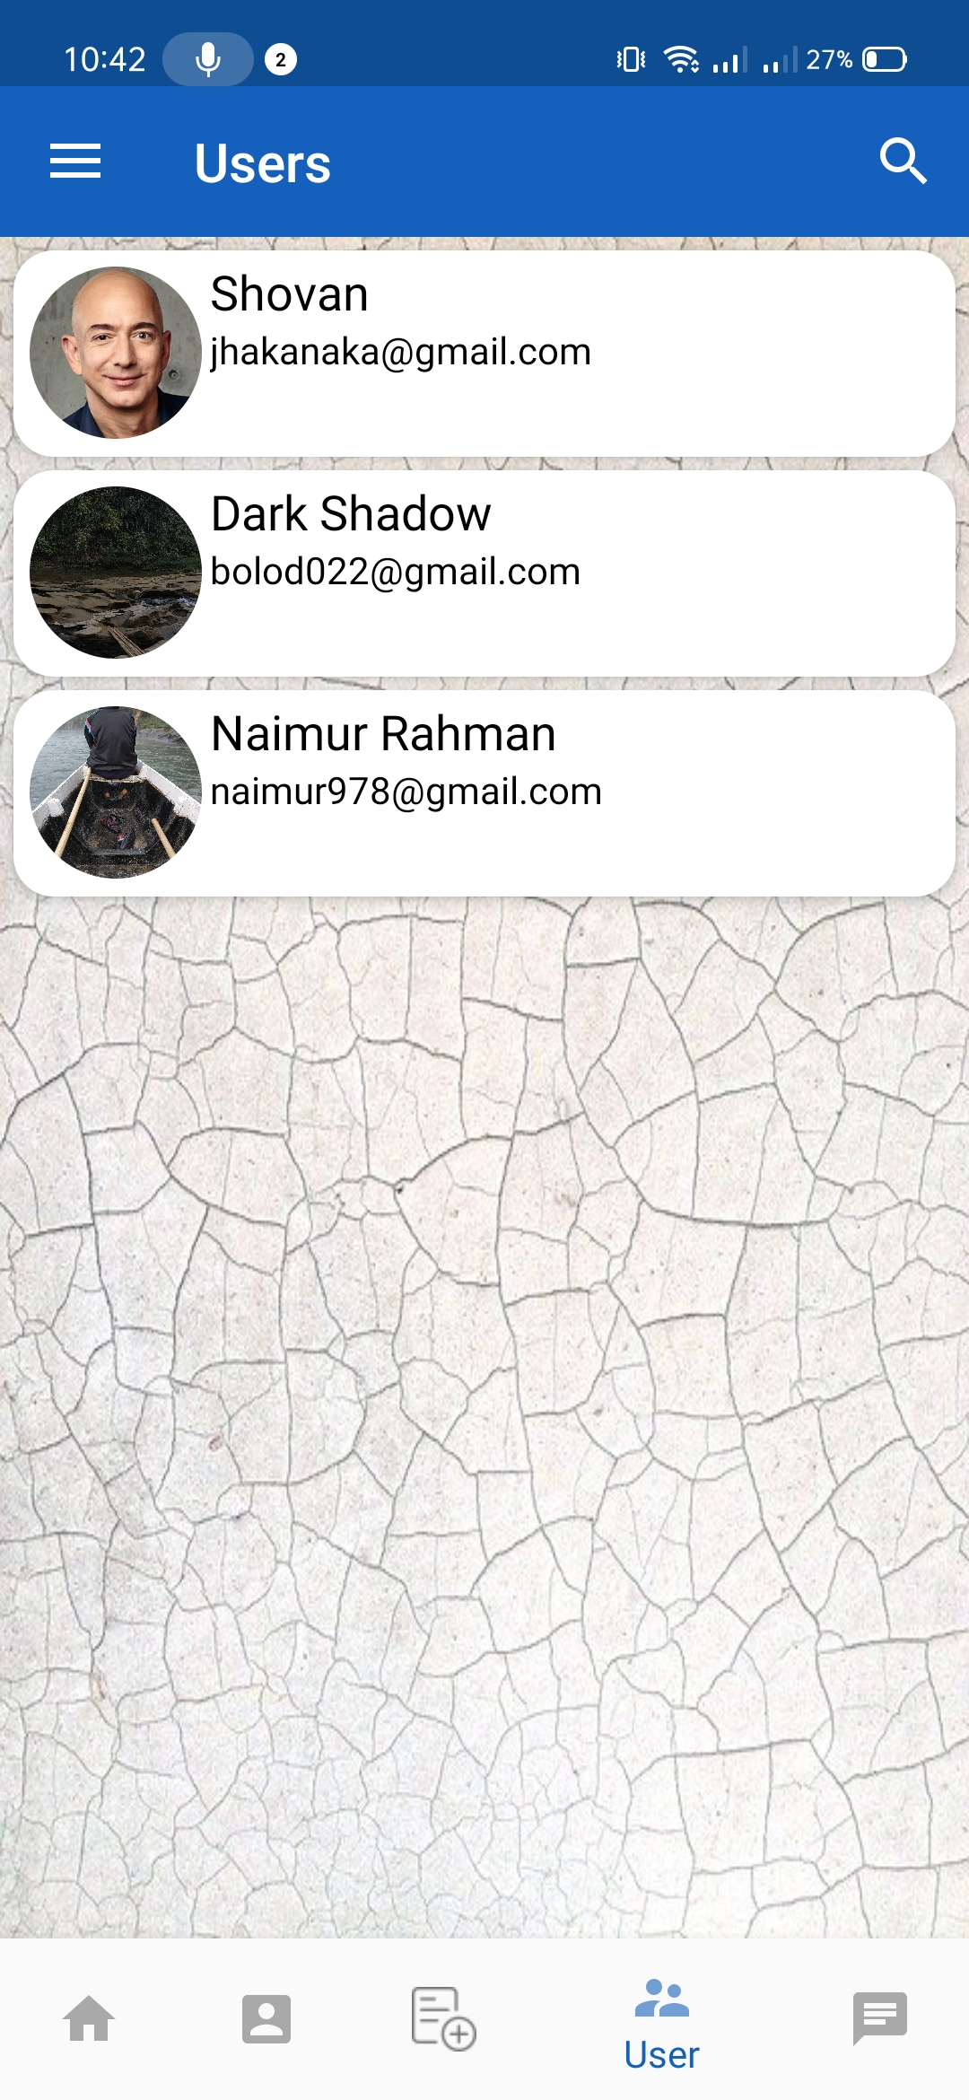
Add Post
Pick Option
Users

Slide 27
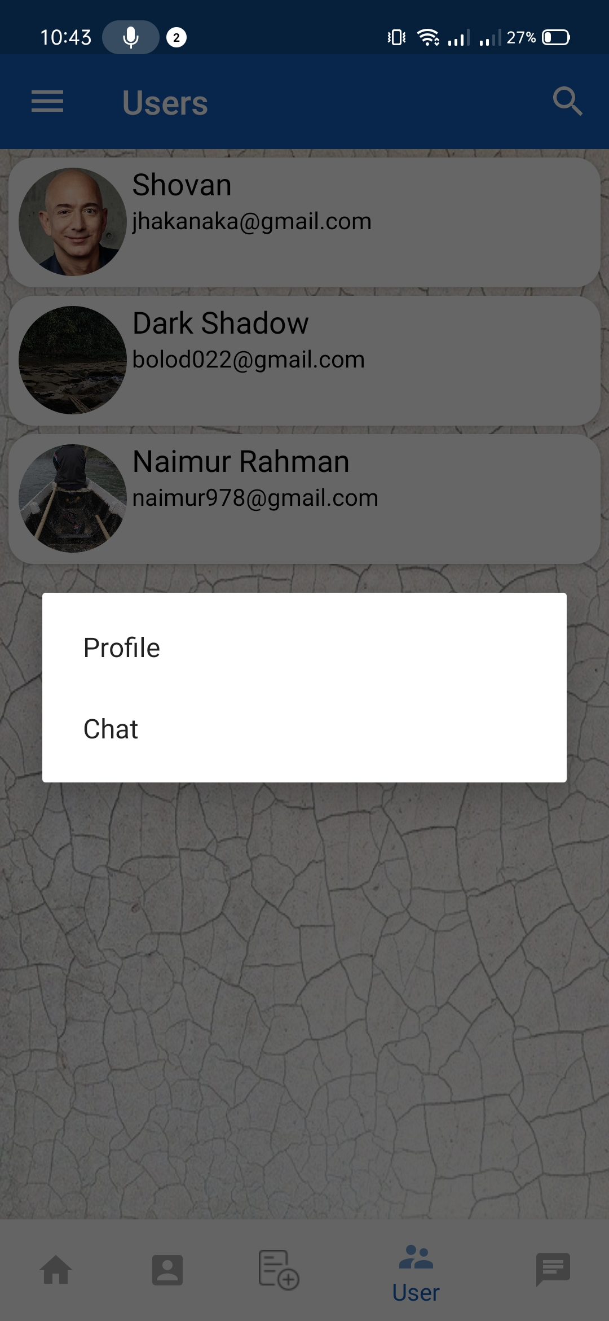
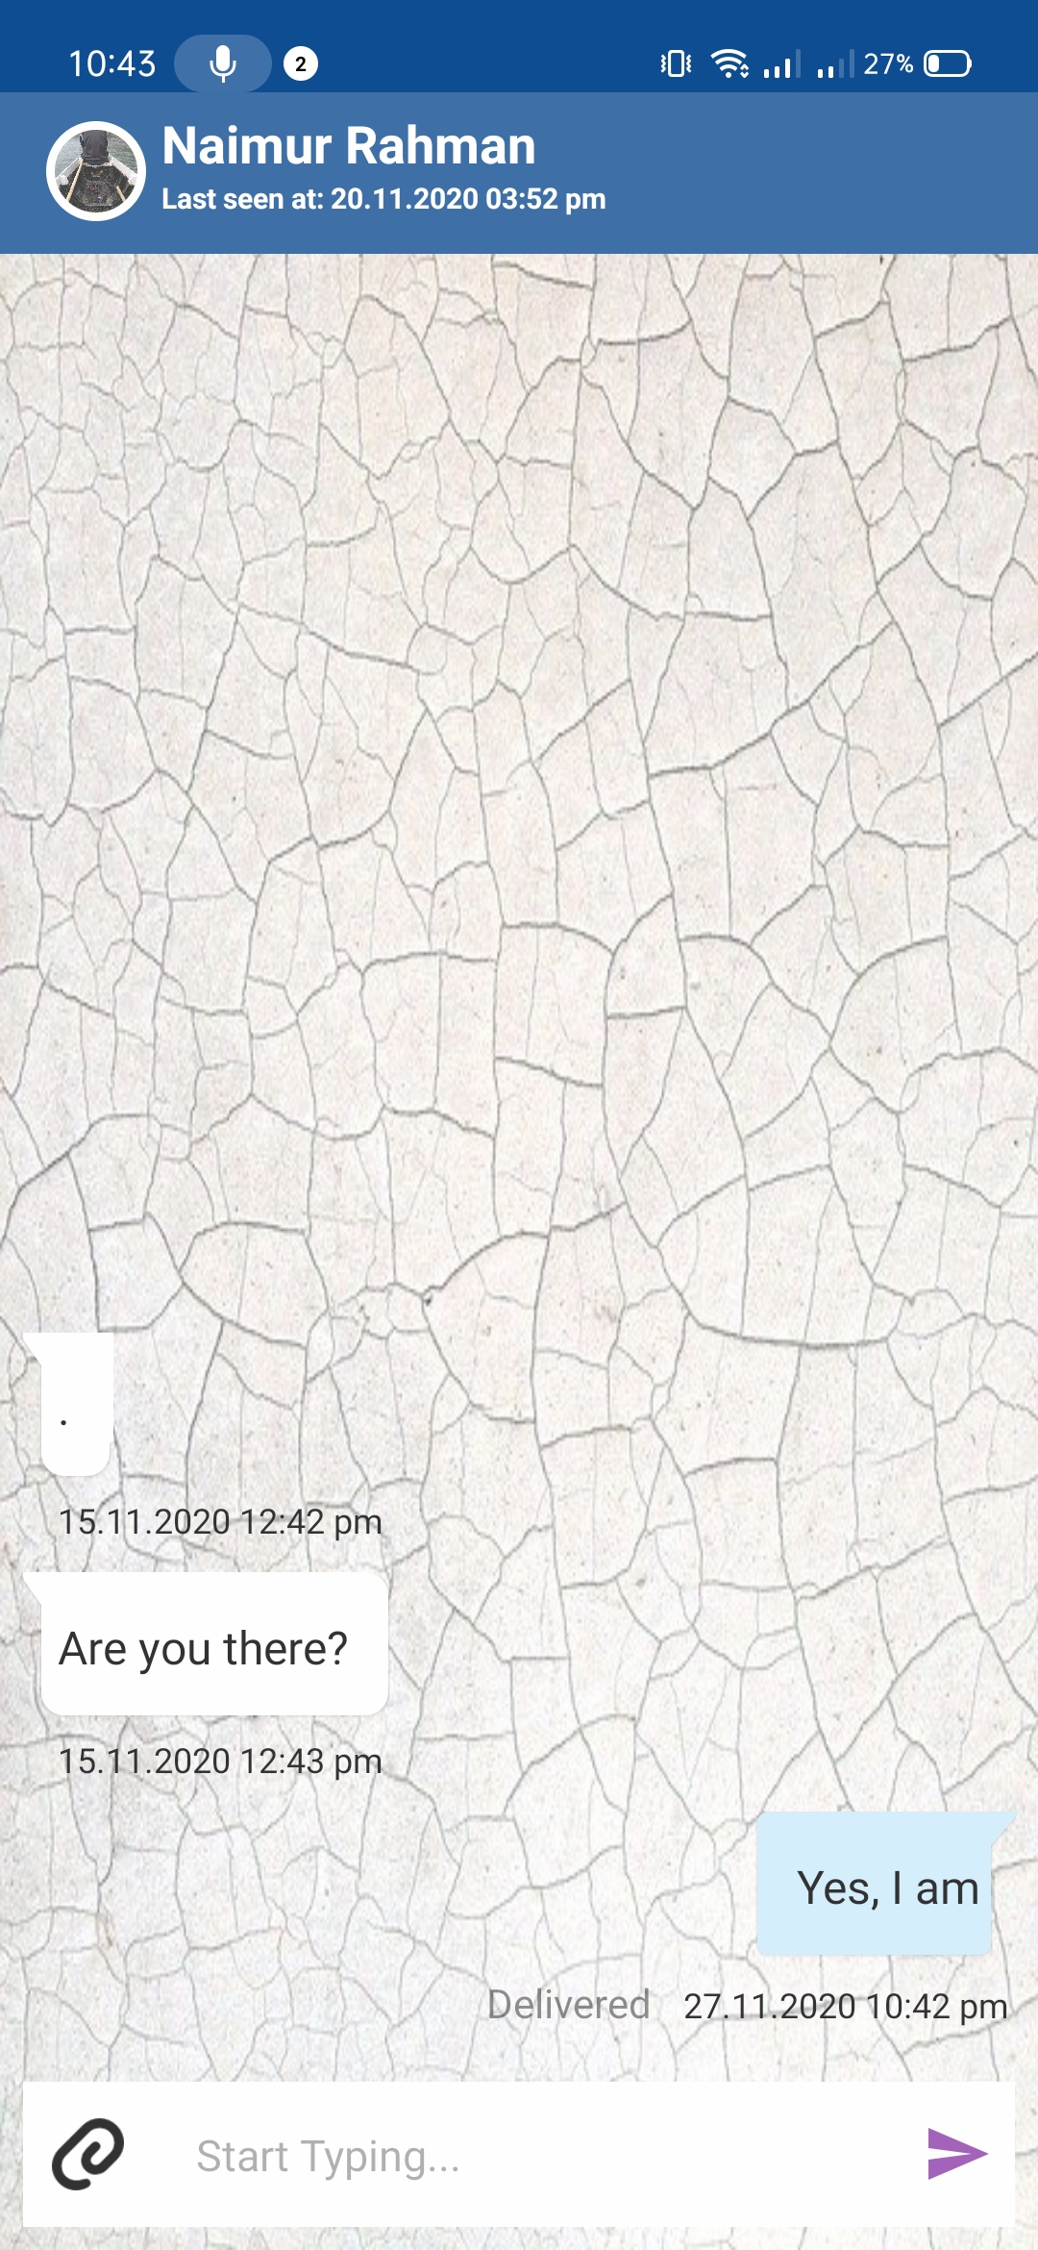
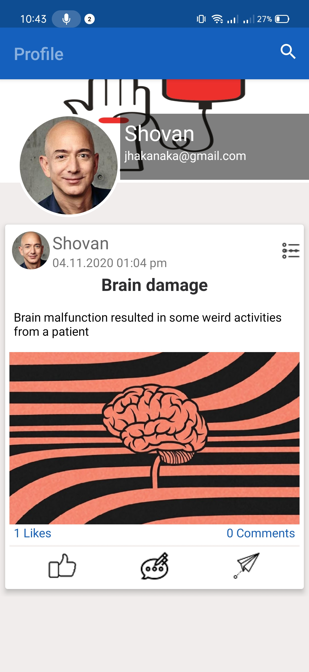
Users Option
Chat
Their Profile

Slide 28
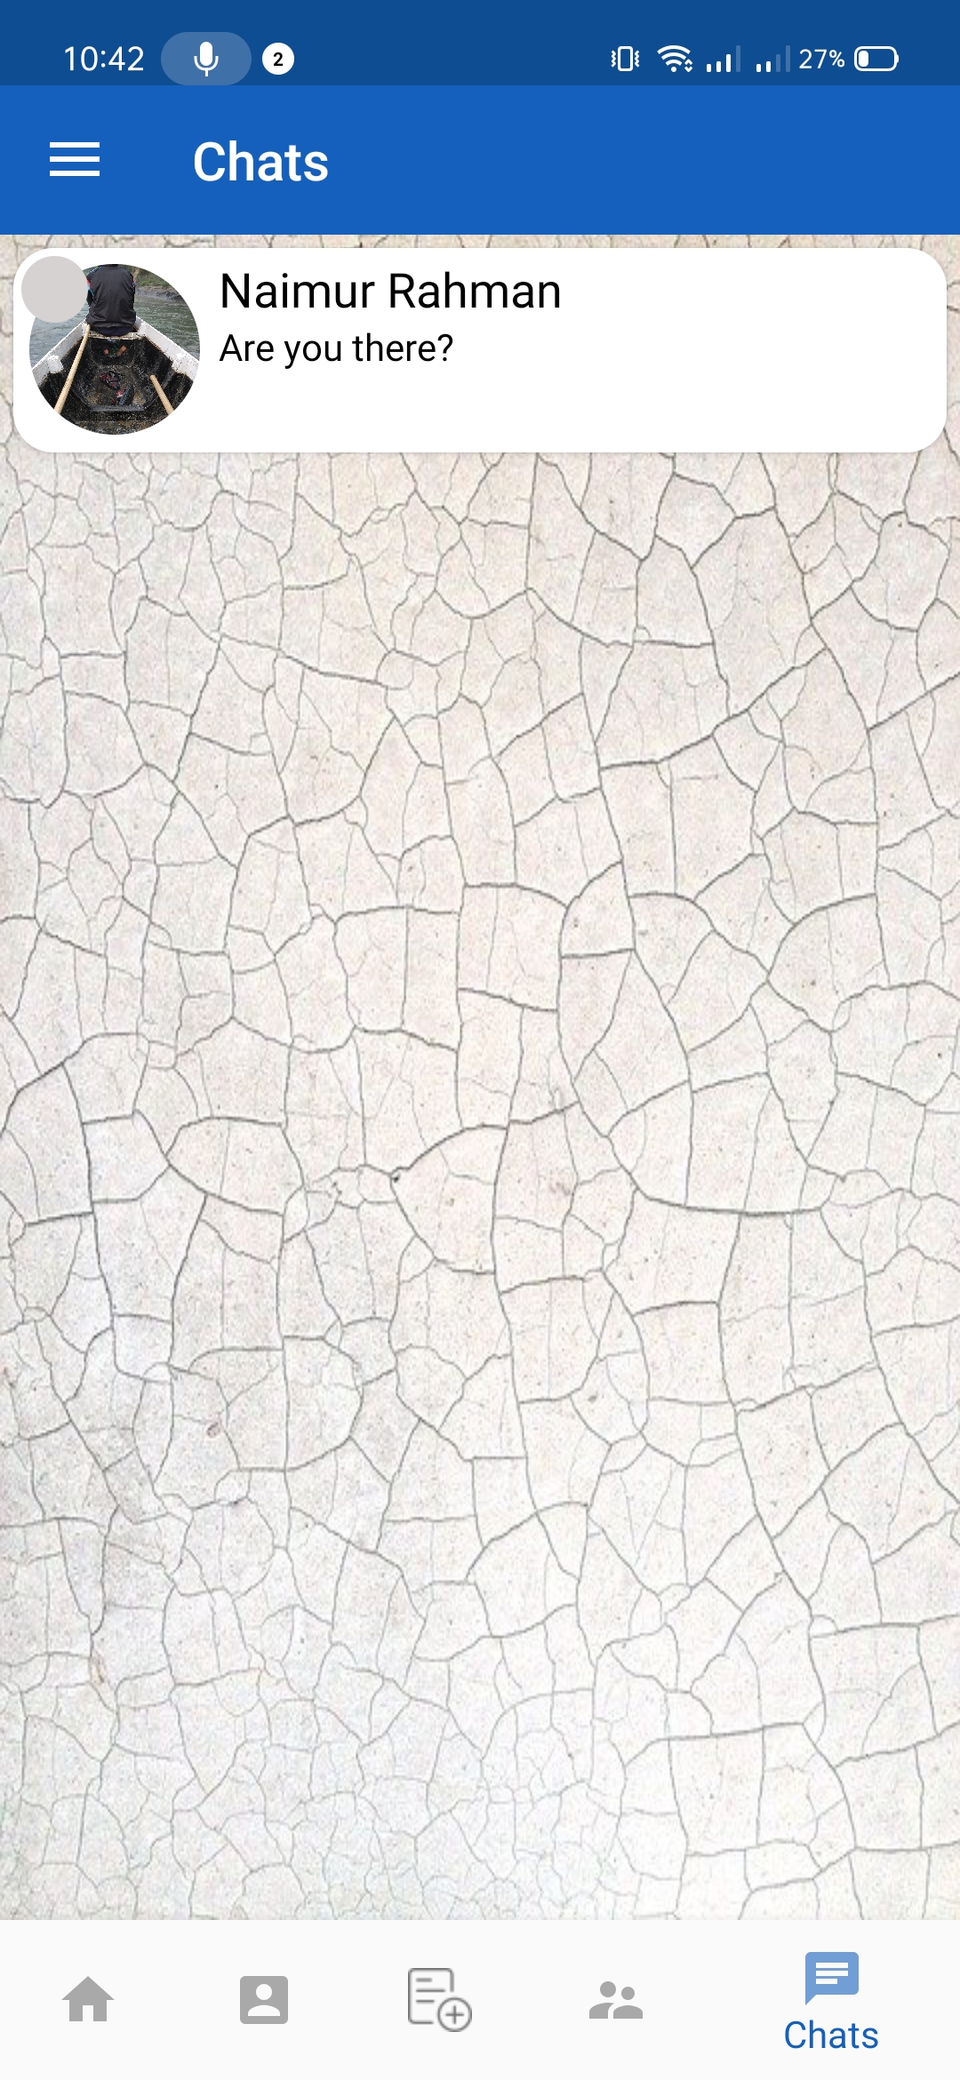
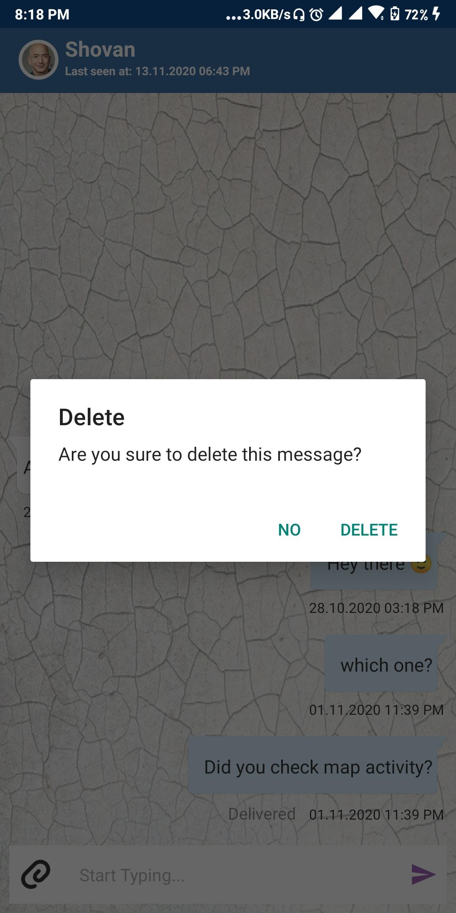
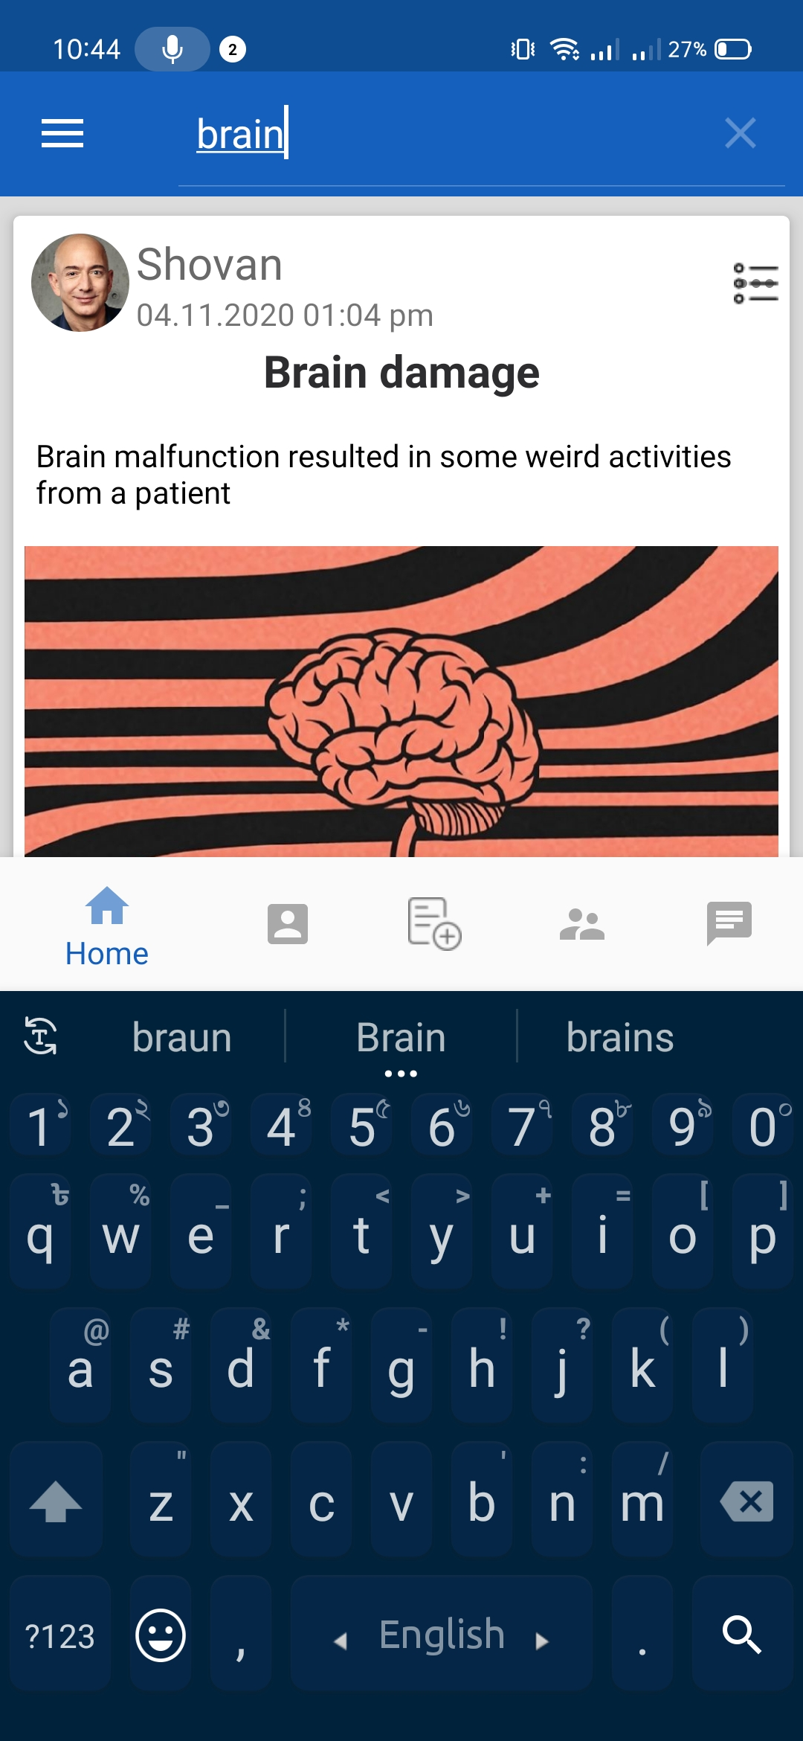
Chat Fragment
Chat Deletion
Searching Post

Slide 29
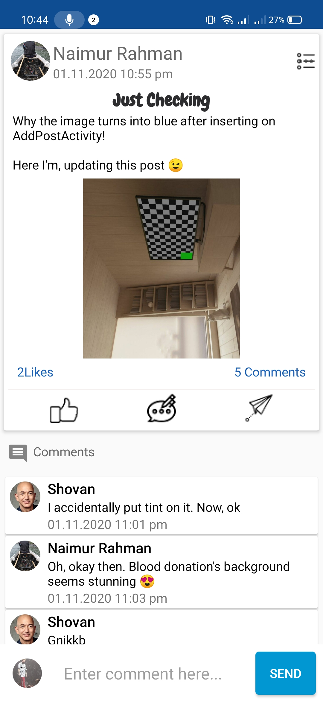
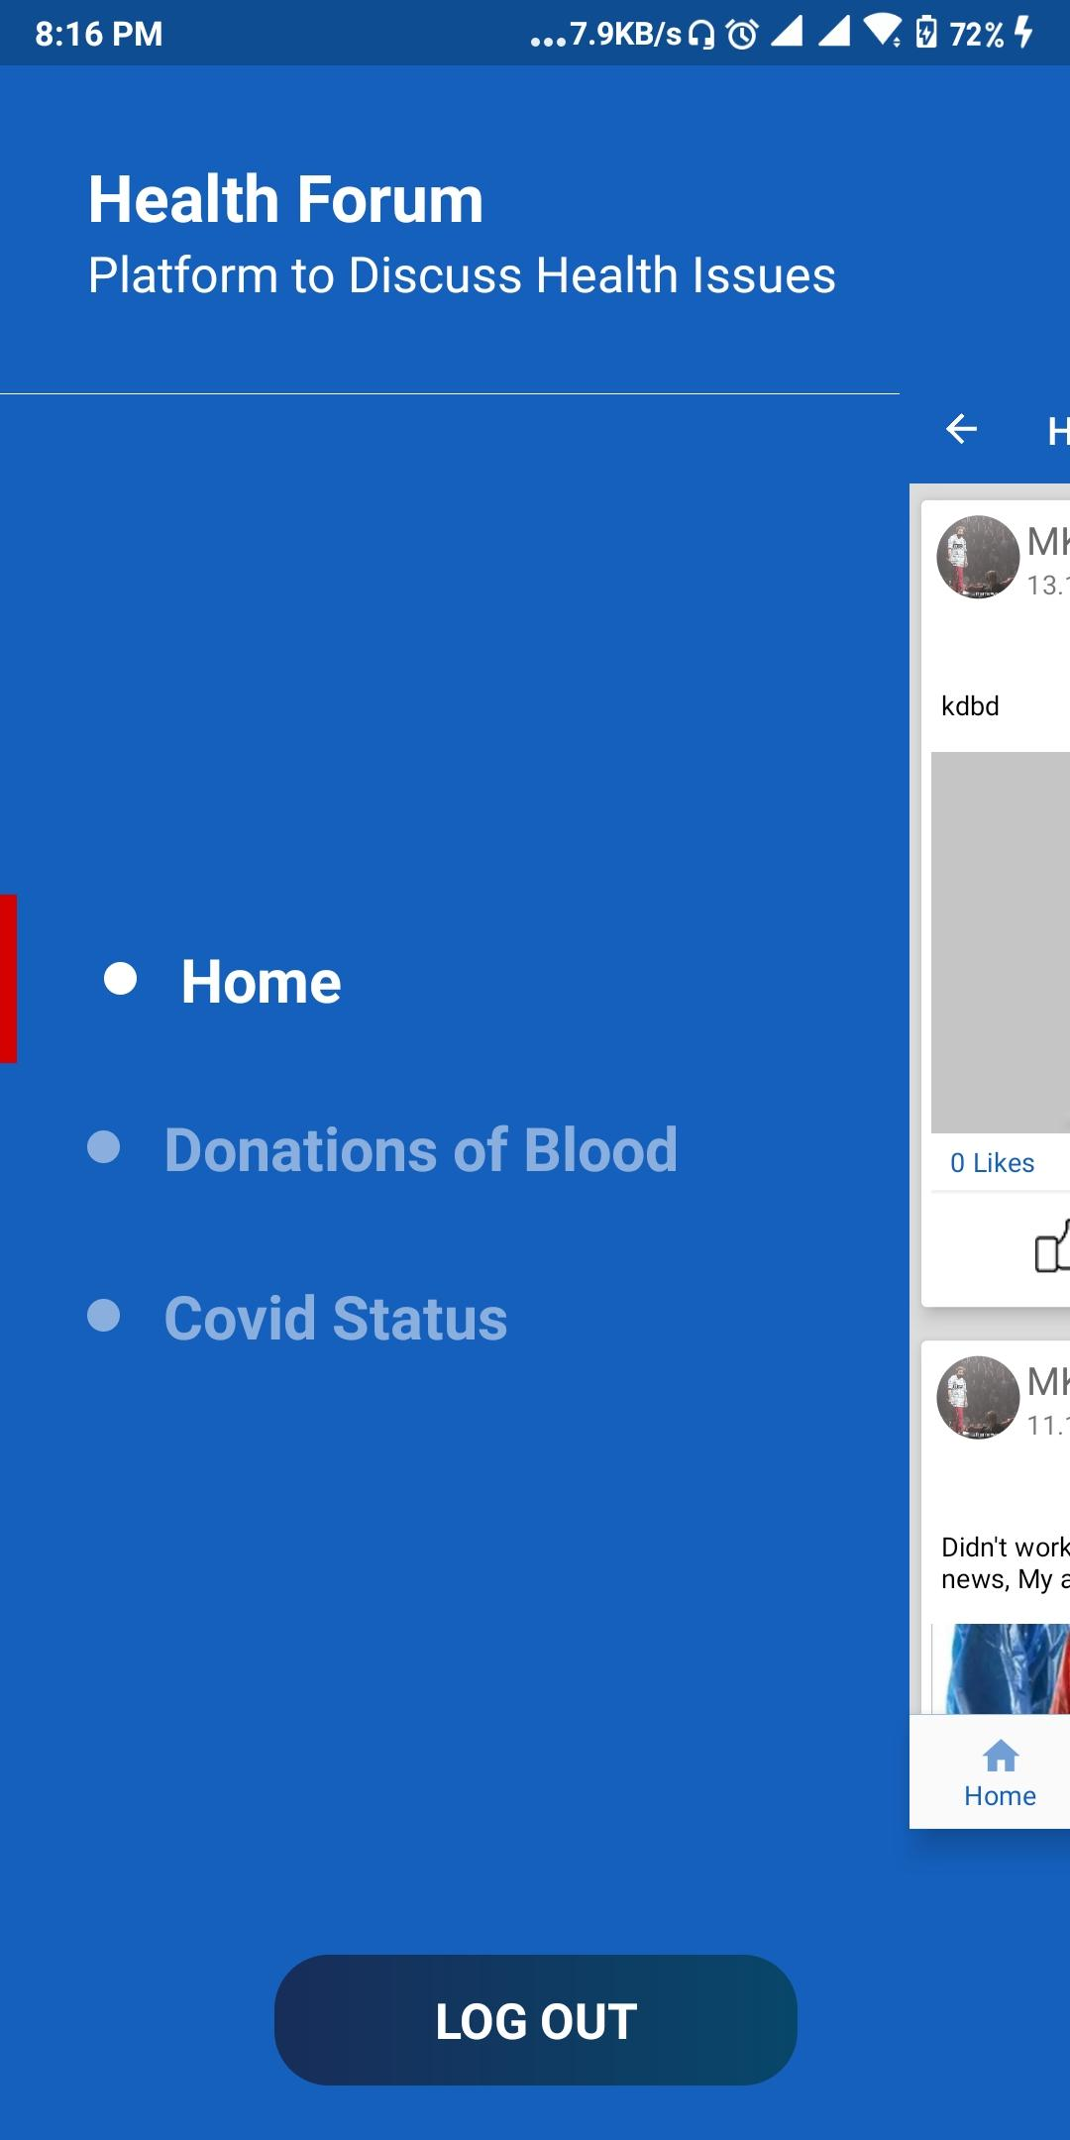
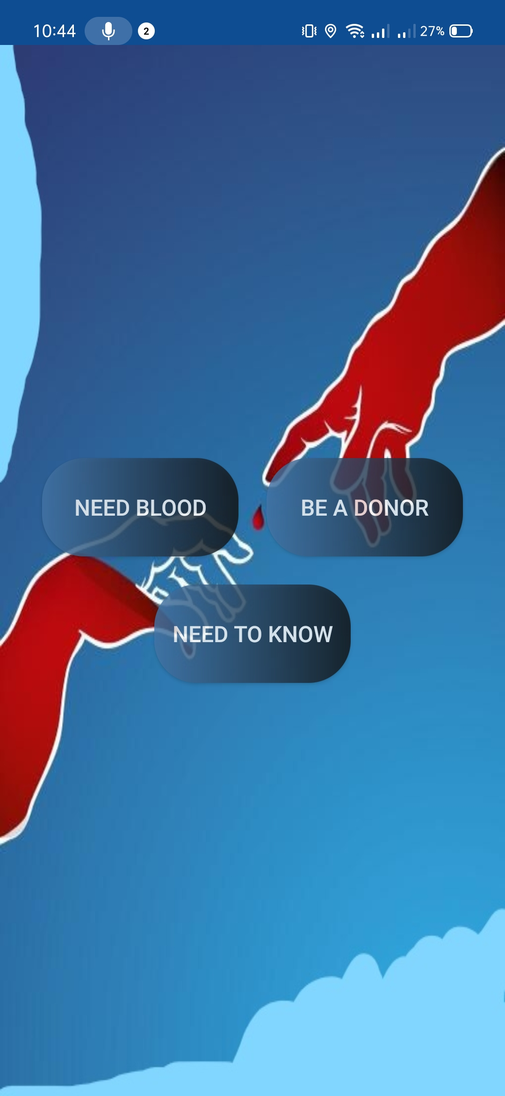
Post Details
Side Nav Panel
Donation of Blood

Slide 30
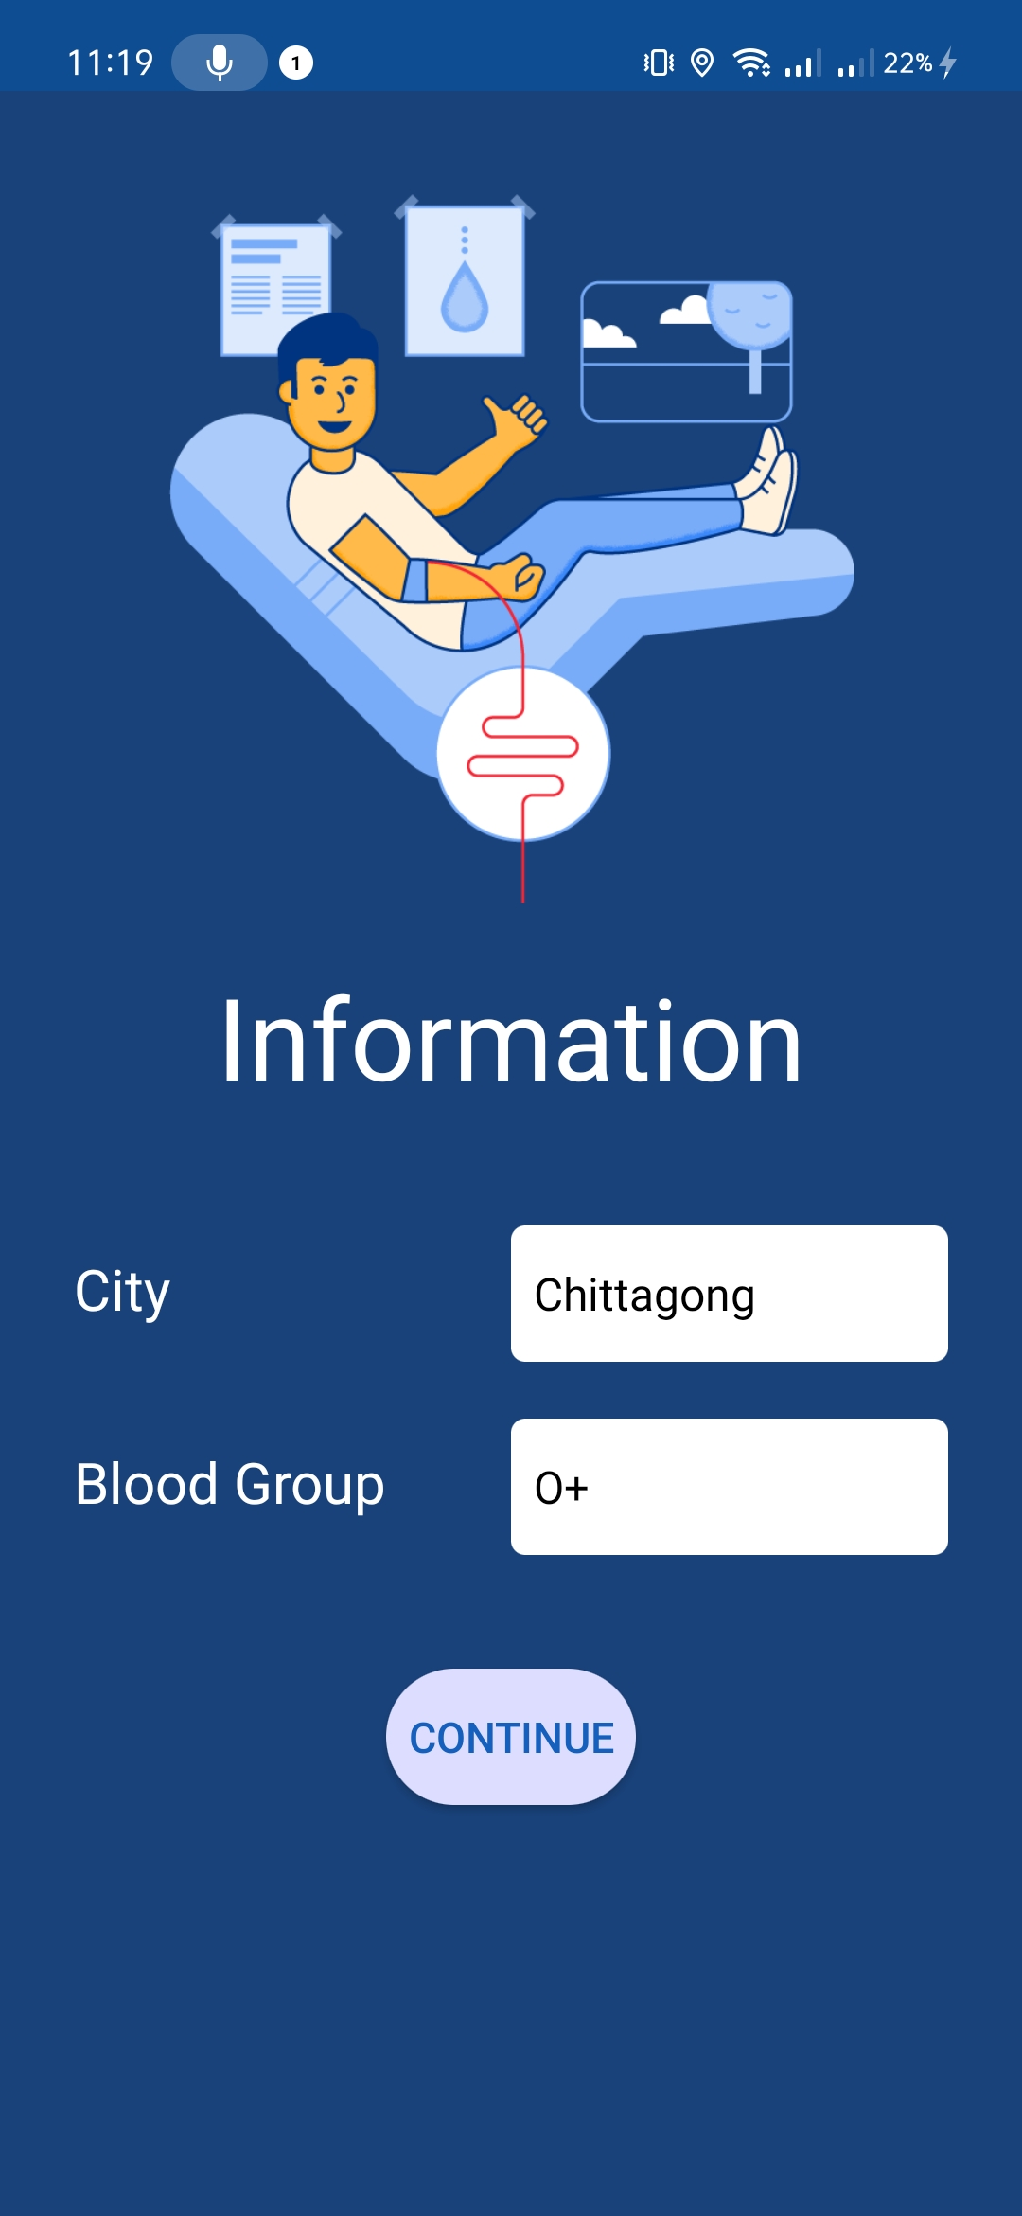
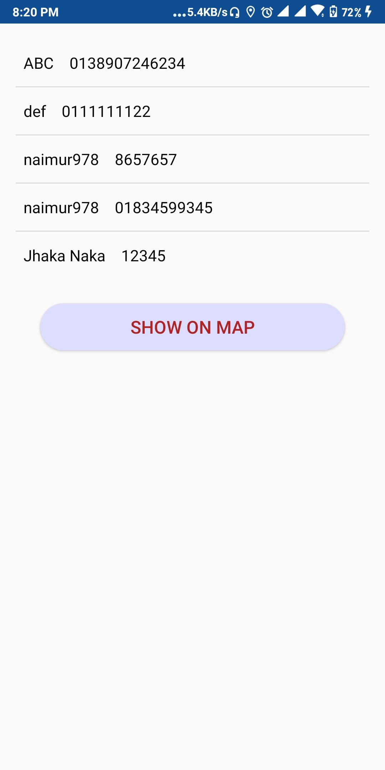
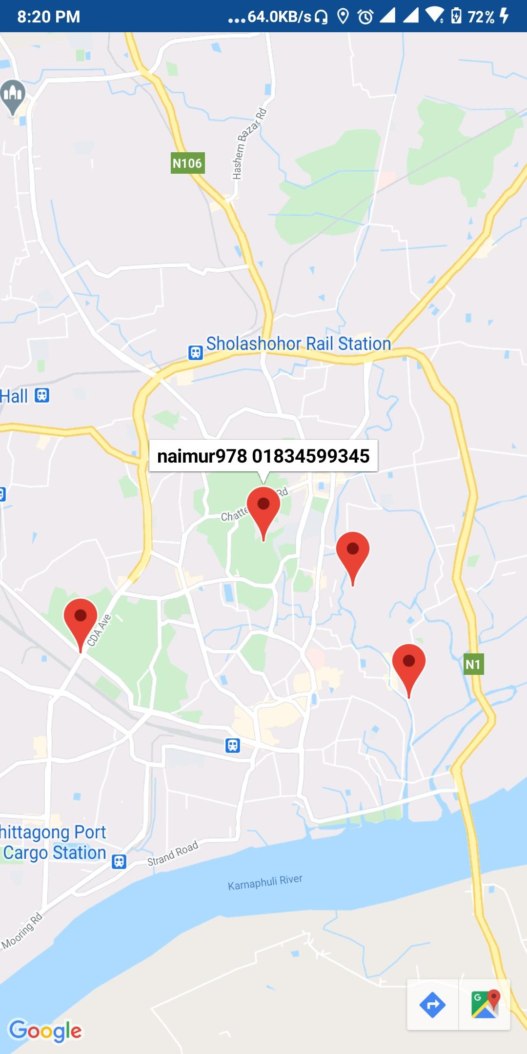
Need Blood
Donors’ List
Donors’ on Map

Slide 31
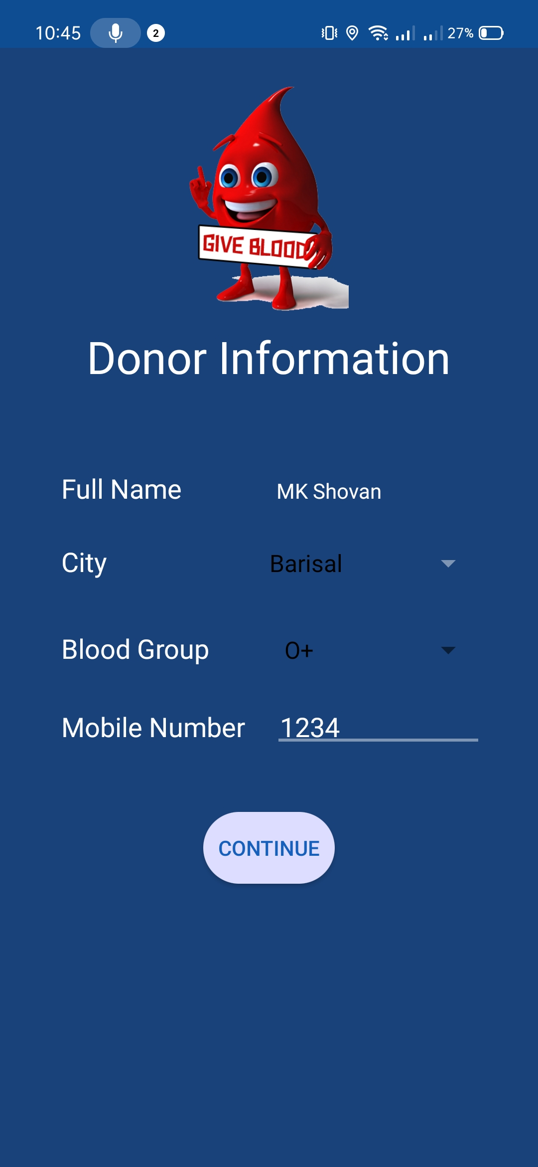
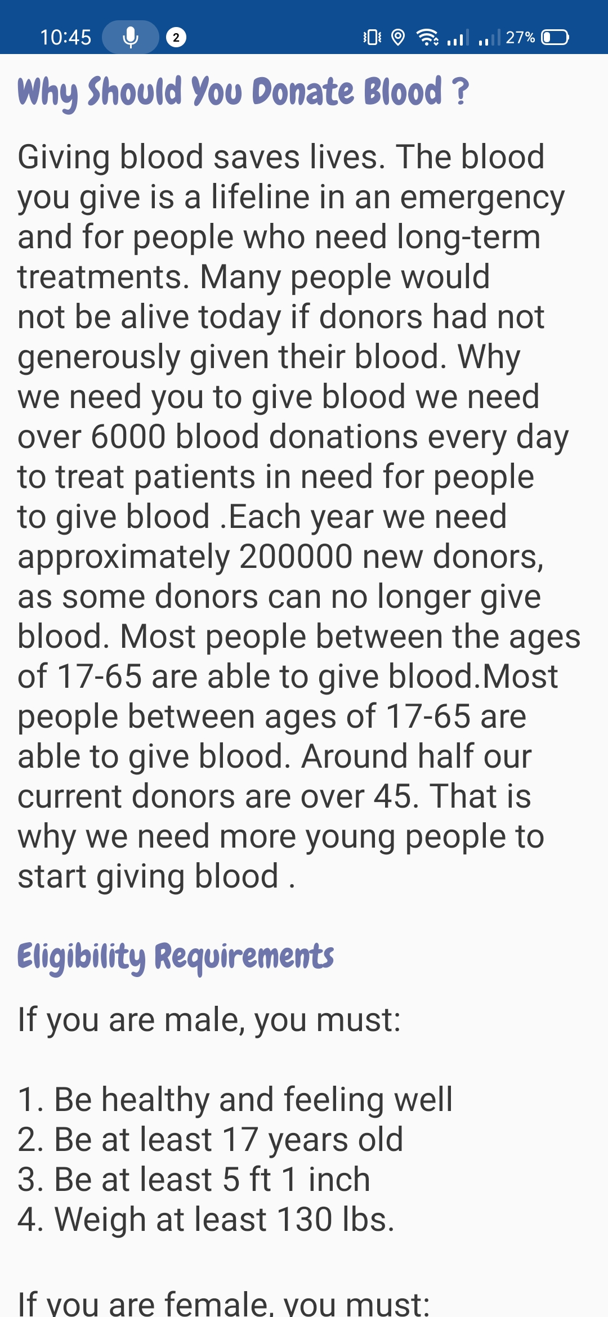
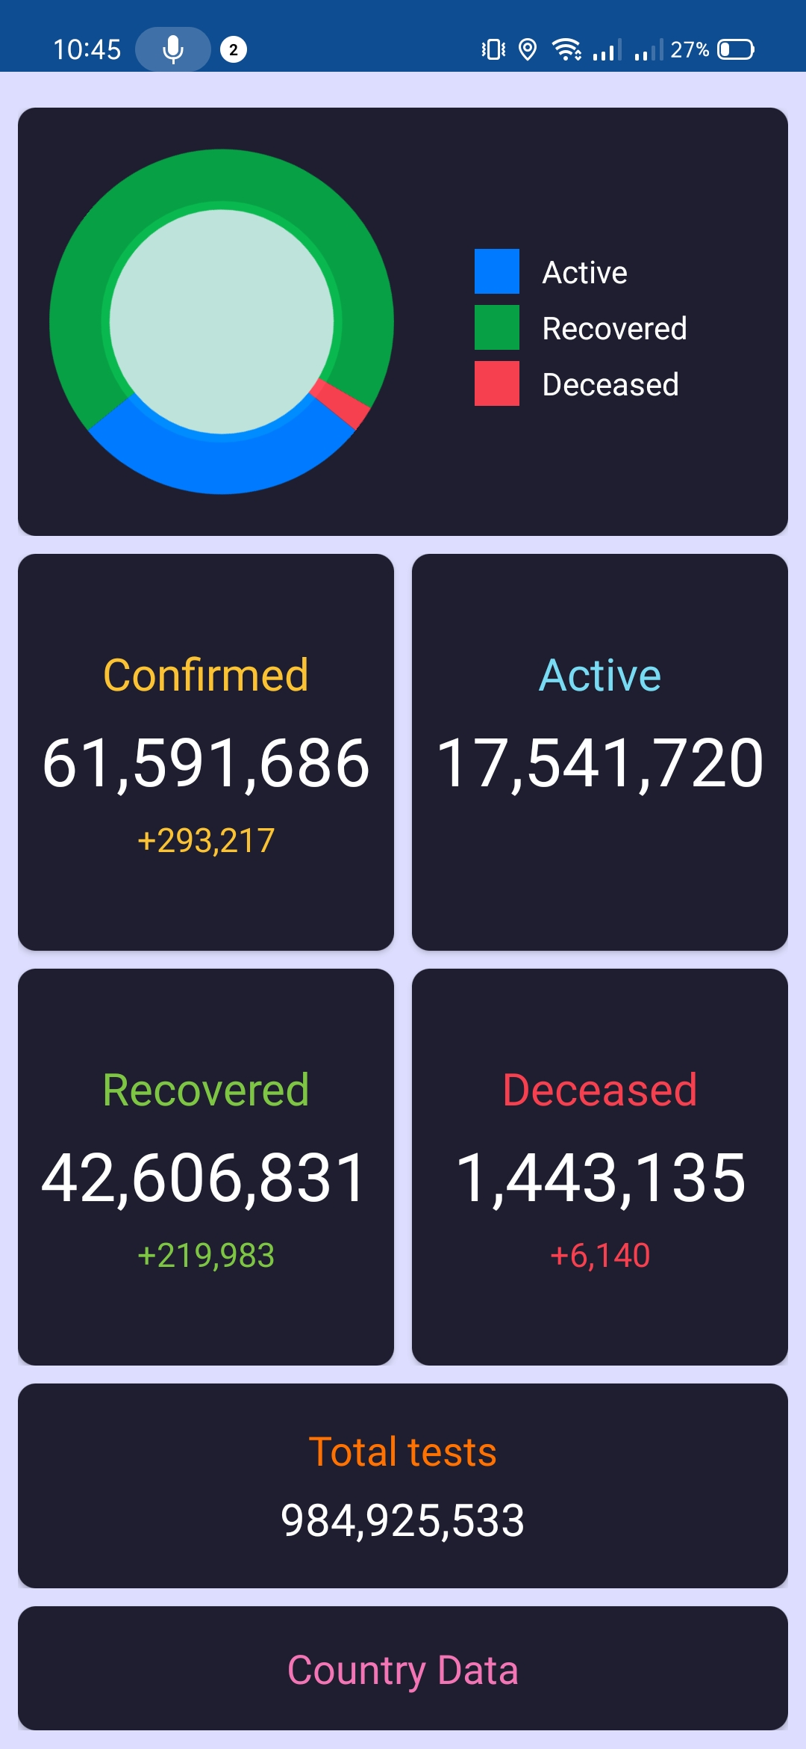
Donor Info Form
Donor Requirements
Covid World Data

Slide 32
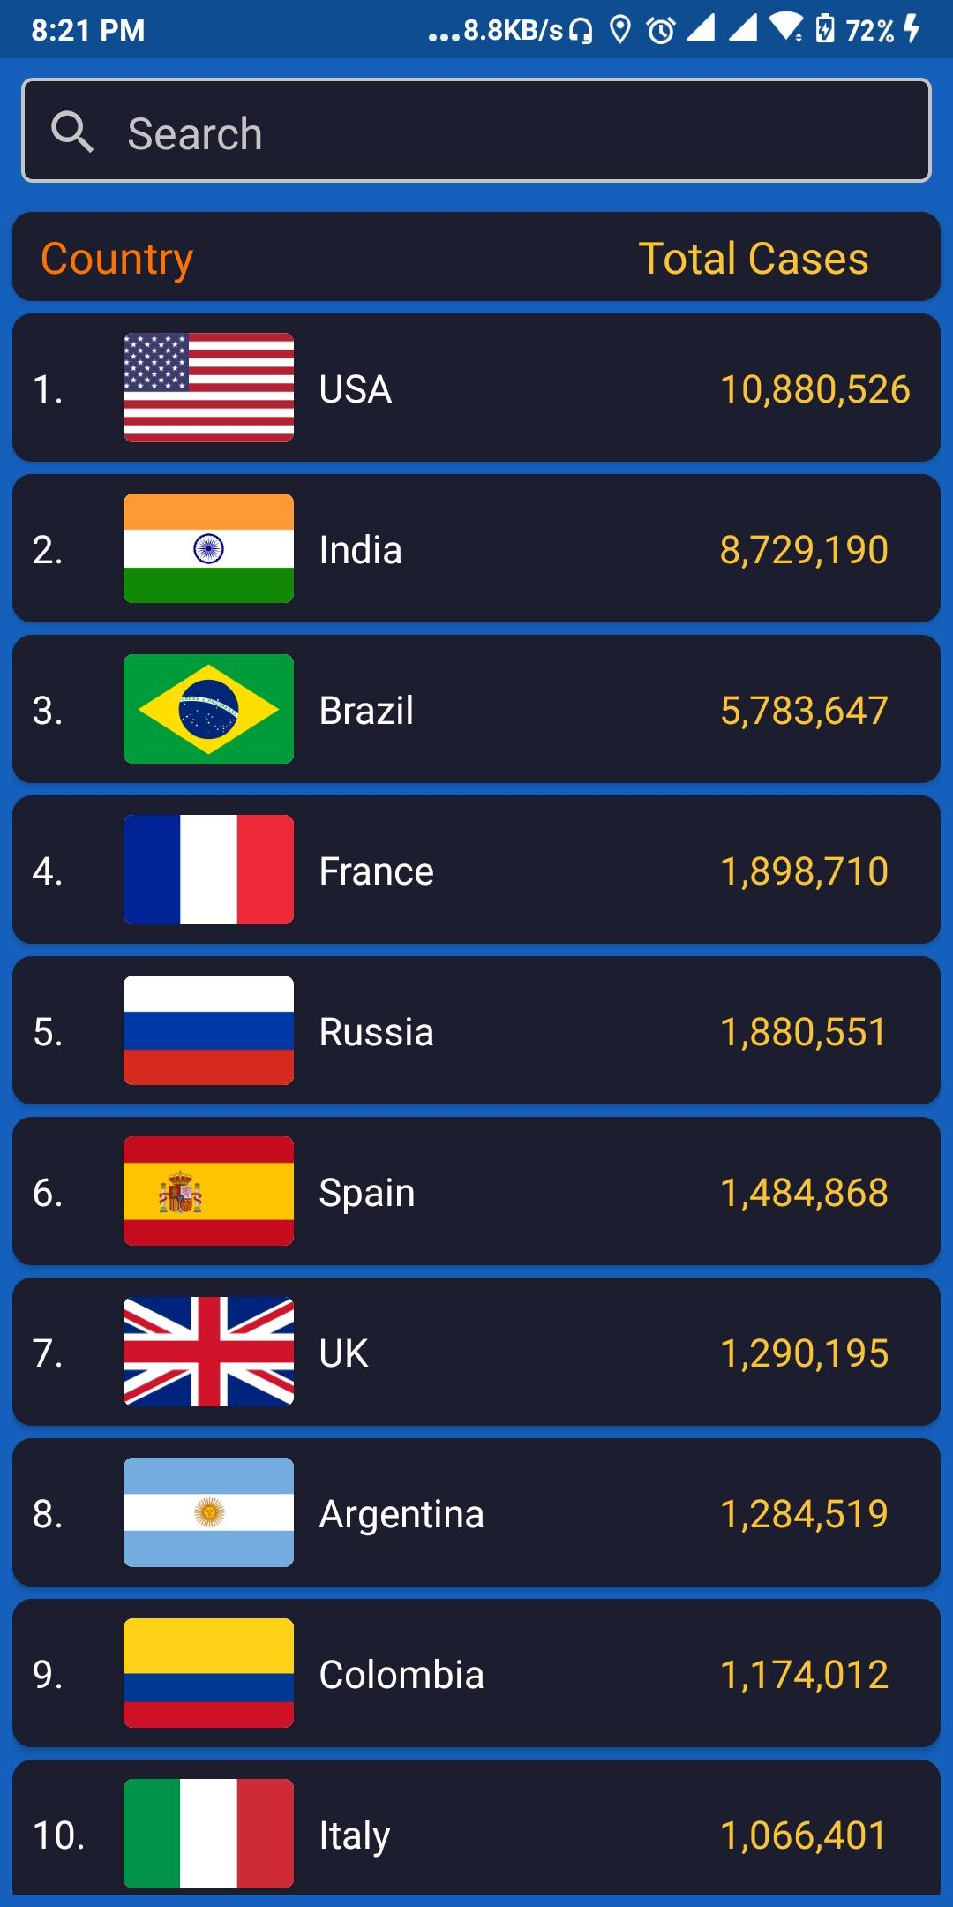
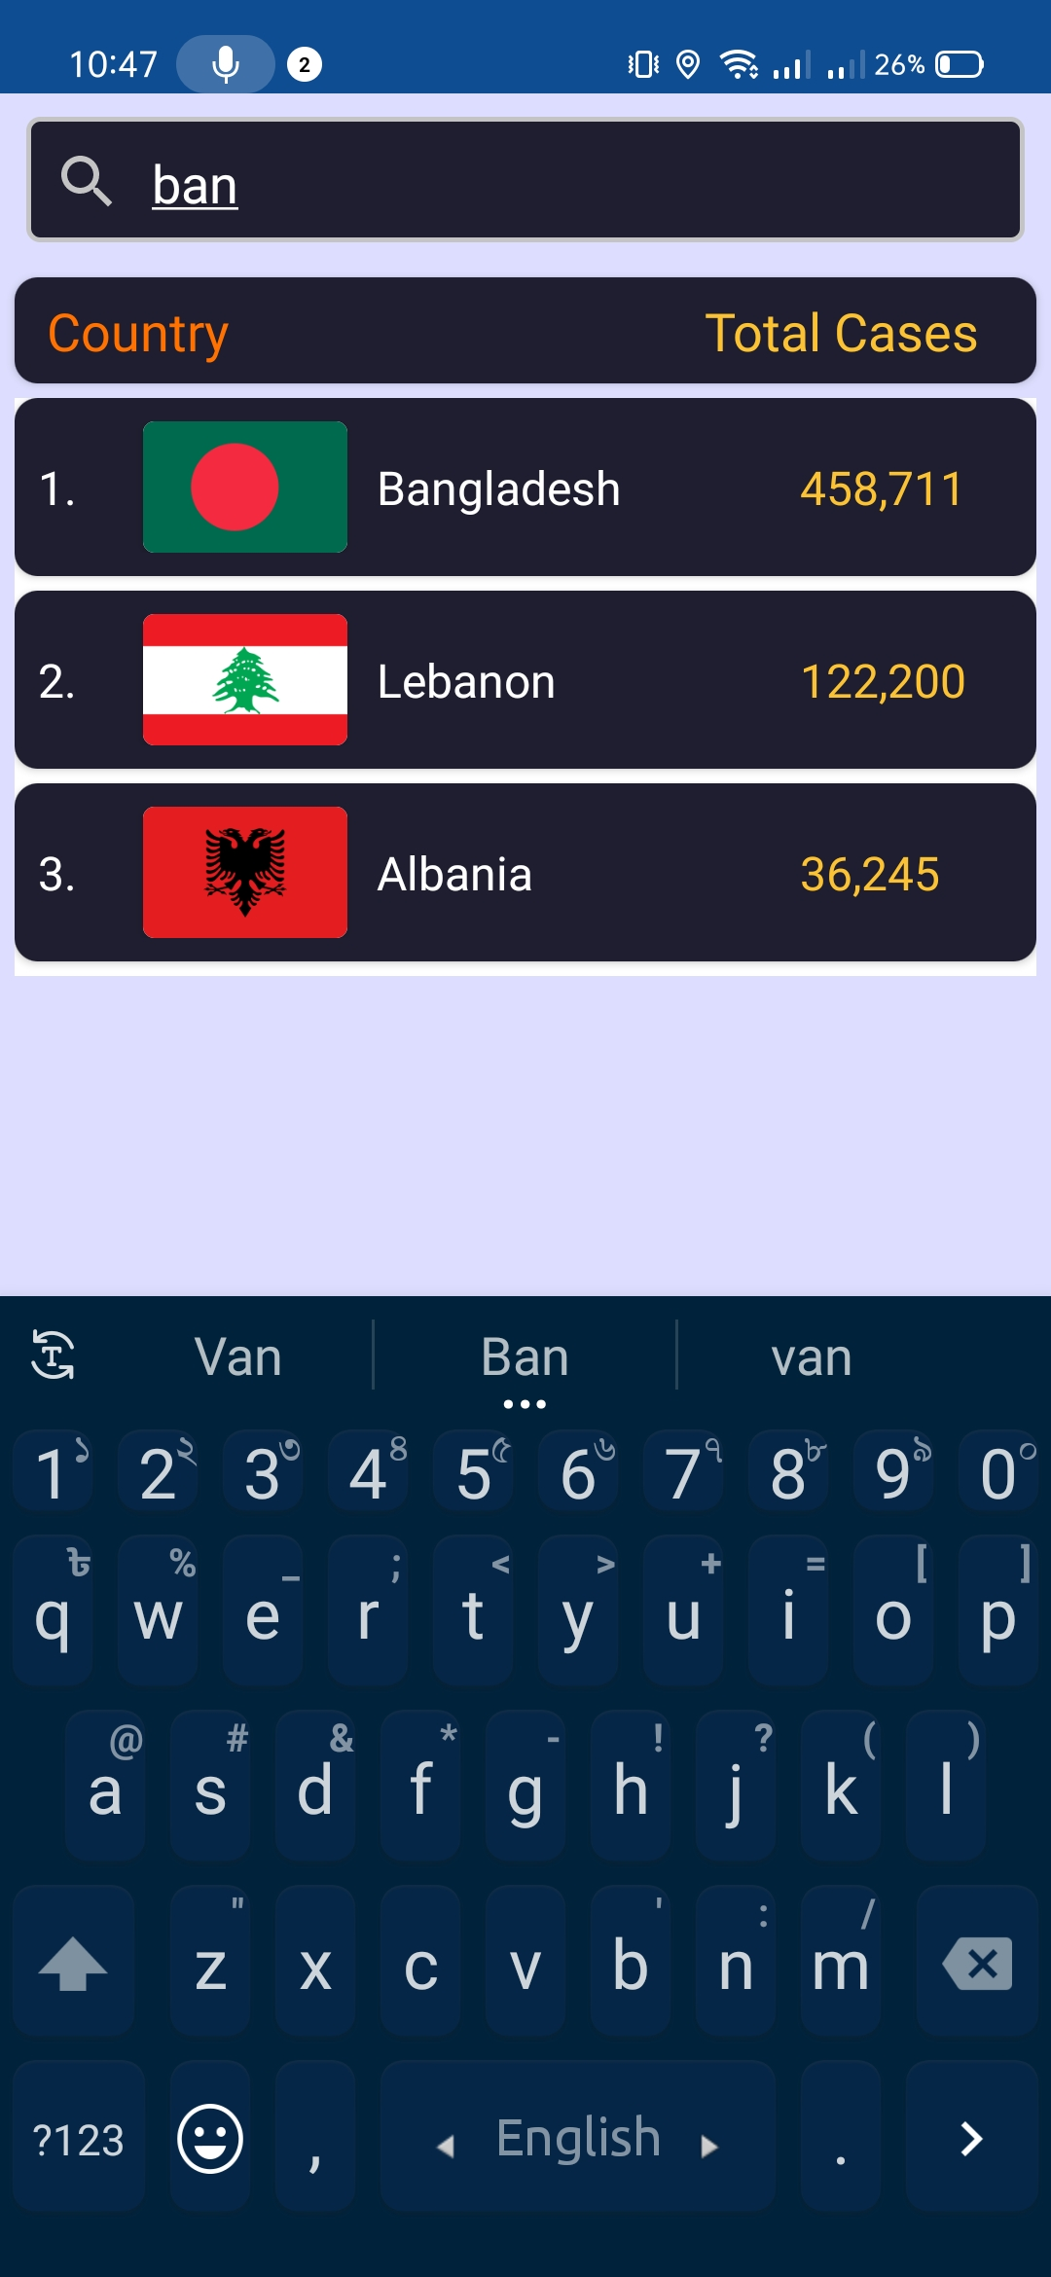
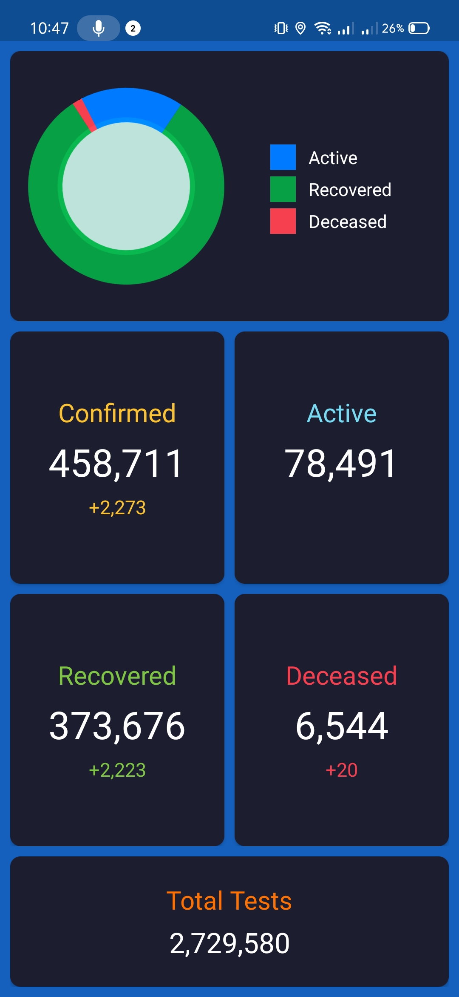
List of World Covid data
Search by Country
Covid-19 data Bangladesh

Slide 33
Future Plan
Right now, we are accepting mail accounts for account creation. In future, we’ll add-
OTP verification
Speech to Text conversion
More animations and images for better UX
Bangla as another app language
Cross-platform Development

Slide 34
Thank You

Slide 35
Questions ?

